Slide 1



LEGAL STRUCTURES & CHARITABLE STATUS
A workshop for Volleyball Clubs
X
Delivered for Scottish Volleyball | University of Stirling | 20th September 2026
Presented by Dr Andrew Jenkin, Club Development Solutions

Slide 2

ABOUT US
Club Development Solutions
We've led the incorporation of 50+ sports clubs across the UK into charitable and community structures.
Helped clubs raise £400,000+ in grants and £6 million+ through community shares.
We deliver ongoing governance and funding support in partnership with Scottish Athletics, Scottish Golf, Basketball Scotland and Scottish Swimming.
Governing Body Partners
Clubs We Support Directly
Scottish Athletics · Scottish Golf · Scottish Swimming
Basketball Scotland · Scottish Gymnastics
Athena Glasgow · Coventry Community Sports Hub
Grangemouth Community Sports Hub · Zenkai Judo Club
"They've built a genuine understanding of how clubs actually operate, their voluntary nature, funding pressures, and different appetite for change from one committee to the next."
Colin Hutchison, CEO, Scottish Athletics
Club Development Solutions | Scottish Volleyball
1

Slide 3
WHO WE ARE
Club Development Solutions
70+
45+
£6m+
£560m
Community sports clubs supported across the UK
Successful charity applications delivered for clubs
Raised by clubs we've supported through community shares and grant funding
Gift Aid left unclaimed by UK charities last year, we help clubs stop leaving it on the table
Grassroots clubs are under pressure: 32% have no financial reserves, and most manage governance, funding and compliance with little outside support.
Club Development Solutions helps clubs across the UK fix that, from charitable incorporation and Gift Aid to trustee training and funding, so committees can focus on delivering sport.
Club Development Solutions | Scottish Volleyball
2

Slide 4
TODAY'S SESSION
By the End of Today, You Will Be Able To…
Explain the difference between unincorporated and incorporated clubs, and what that means for personal liability
Compare the main legal structures open to volleyball clubs, CLG, CBS, CIC, SCIO and CASC, and their advantages and disadvantages
Understand what charitable status means in practice: the Charity Test, Gift Aid, and the wider benefits available (Google for Nonprofits, discount platforms, and more)
Understand what running a SCIO properly looks like, trustee duties, annual reporting and OSCR compliance
Know what the incorporation process and timeline looks like
Club Development Solutions | Scottish Volleyball
4

Slide 5

01
Incorporation
Why the legal 'plumbing' of your club matters more than most committees realise.
Club Development Solutions | Scottish Volleyball
5

Slide 6
"
Often overlooked is the way in which the club is set up legally, and the impact that this may have on the financial and legal position of the club.
On why legal structure matters for sports clubs
Club Development Solutions | Scottish Volleyball
6

Slide 7
WHERE MOST CLUBS START
Unincorporated Associations
The majority of the UK's 13,000+ sports clubs are unincorporated associations, a group of people bound together by a common constitution
Flexible and simple to administer, no registration, no regulator, minimal paperwork
Governed by a management committee, accountable mainly to its own membership
Fine for small, low-risk clubs with modest turnover and no premises or employees, but the flexibility comes at a cost, which we'll come to next
Club Development Solutions | Scottish Volleyball
7

Slide 8
THE TRADE-OFF
The Liability Problem
What goes wrong
Why insurance isn't enough
An unincorporated club has no legal personality, it cannot enter contracts, employ staff, or own property in its own name
Committee members personally sign leases, contracts and employment agreements on the club's behalf
Liability is unlimited and not shared proportionately, one committee member can be pursued for the whole debt
Real examples exist of clubs (and their volunteers personally) being chased for unpaid bills, injury claims and employment disputes
Public liability and D&O insurance help, but won't cover every scenario, e.g. contractual disputes or deliberate breaches
A big, unexpected bill with insufficient club funds means committee members, often whoever has the most personal assets, get targeted
Title to land and property must sit in individual names, creating risk for both the individual and the club if that person leaves
As clubs grow (more members, staff, premises, income), this exposure grows with them
Club Development Solutions | Scottish Volleyball
8

Slide 9

Advantages of Staying Unincorporated
Simple to set up, founded purely by agreement between members, no registration required
Private, no requirement to file accounts or constitutions publicly with a regulator
Lower compliance costs and lighter administrative burden
It can genuinely be the right call for a small, low-turnover club with no premises, staff or major assets
The question isn't "is unincorporated bad?", it's "does the risk profile of our club still match this structure?"
Club Development Solutions | Scottish Volleyball
9

Slide 10
QUICK-FIRE · QUESTION 1
A club's minibus, driven by a volunteer committee member, is involved in an accident. The injured party sues. The club is unincorporated and has no reserves. Who is legally on the hook?
The club itself, as a separate legal body
A
Scottish Volleyball, as the governing body
B
The insurer only, in every circumstance
C
The individual committee members, personally and without limit
D
Club Development Solutions | Scottish Volleyball
10

Slide 11
QUICK-FIRE · QUESTION 1
A club's minibus, driven by a volunteer committee member, is involved in an accident. The injured party sues. The club is unincorporated and has no reserves. Who is legally on the hook?
The club itself, as a separate legal body
A
Scottish Volleyball, as the governing body
B
The insurer only, in every circumstance
C
The individual committee members, personally and without limit
D
An unincorporated association has no legal personality of its own, so its committee members carry personal, unlimited liability.
Club Development Solutions | Scottish Volleyball
10

Slide 12

02
Legal Structures
The five main routes clubs take when they decide it's time to incorporate.
Club Development Solutions | Scottish Volleyball
11

Slide 13
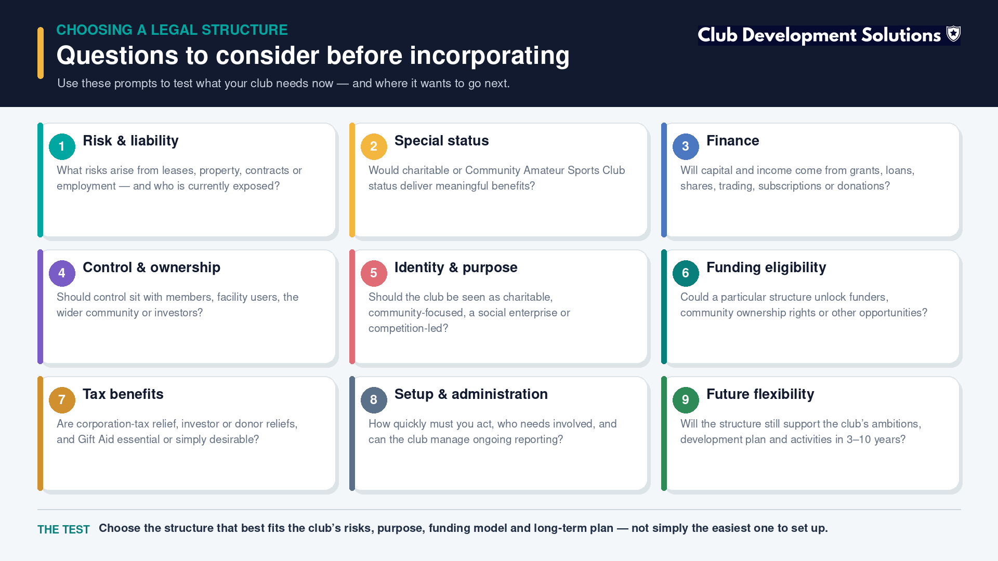

Slide 14
THE LANDSCAPE
The Options At a Glance
Structure | Regulator | Legal Personality | Best Suited To
Unincorporated Association | None (self-governed) | No, no separate legal identity | Very small, low-risk clubs
Company Limited by Guarantee (CLG) | Companies House | Yes, limited liability for members | Clubs wanting full corporate flexibility
Community Benefit Society (CBS) | FCA | Yes, limited liability, co-operative principles | Member-owned clubs, community share raises
Community Interest Company (CIC) | Companies House + CIC Regulator | Yes, asset-locked social enterprise | Clubs wanting a clear social-enterprise identity
Scottish Charitable Incorporated Organisation (SCIO) | OSCR (sole regulator) | Yes, limited liability + charitable status combined | Clubs seeking charitable status with lighter admin
Community Amateur Sports Club (CASC) | HMRC | No, a tax status, not a legal structure | Clubs wanting Gift Aid-style relief without full charity regulation
Club Development Solutions | Scottish Volleyball
12

Slide 15
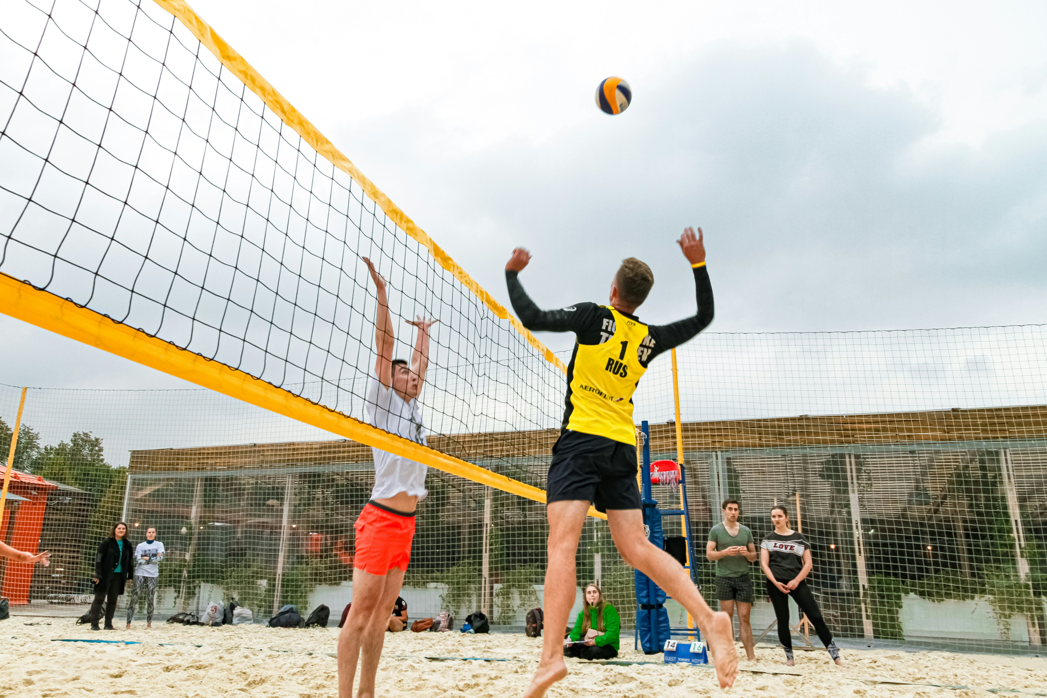
OPTION 1
Company Limited by Guarantee (CLG)
A separate legal entity, the club can hold assets, enter contracts and employ staff in its own name
Members' liability is limited to a nominal guaranteed sum (typically £1) if the company is wound up
Directors and members are protected against personal claims, provided company law requirements are met
Regulated by Companies House, annual accounts and a confirmation statement must be filed and are publicly available
Can also apply for charitable status on top (a "charitable CLG"), though this brings dual regulation by both Companies House and OSCR
Club Development Solutions | Scottish Volleyball
13

Slide 16
OPTION 2
Community Benefit Society (CBS)
A type of Industrial and Provident Society, regulated by the Financial Conduct Authority (FCA)
Provides a separate legal identity and protects members' liability, while being reasonably straightforward to set up
Must demonstrate it is run for the benefit of the community, not private gain
Operates on co-operative principles (one member, one vote), which suits membership-driven clubs
A strong option where a club wants to raise capital directly from its community through a community shares offer
Often unfairly overlooked by banks, funders and local authorities simply because it's less well known than a CLG
Club Development Solutions | Scottish Volleyball
14

Slide 17
OPTION 3
Community Interest Company (CIC)
A company that exists specifically to operate for the benefit of the community, must apply and demonstrate community benefit to register
Company members enjoy limited liability, and CICs must meet requirements around how assets are used (the "asset lock")
Offers a clear, recognisable limited-company structure with a social-enterprise identity
Important trade-off: CICs receive no charity tax reliefs, but do carry additional administration on top of standard company requirements
Worth considering where a club's activity sits closer to social enterprise/trading than to a traditional charitable purpose
Club Development Solutions | Scottish Volleyball
15

Slide 18

OPTION 4
Community Amateur Sports Club (CASC)
Not a legal structure in itself, a tax status registered with HMRC, which can sit on top of an existing structure (including unincorporated)
To qualify, a club must: be open to the whole community; be organised on an amateur basis; have promoting participation in eligible sport as its main purpose; and meet the location test
Benefits include mandatory business rates relief and the ability to claim a form of tax relief on donations
Simpler and quicker to obtain than full charitable status, but the reliefs available are narrower than those open to a registered charity
A number of clubs run CASC and charitable status side by side against different parts of their income
Club Development Solutions | Scottish Volleyball
16

Slide 19
QUICK-FIRE · QUESTION 2
A club wants to raise £50,000 directly from its members and local community through a share offer, with a one-member-one-vote structure. Which option is purpose-built for that?
Community Interest Company (CIC)
A
Community Benefit Society (CBS)
B
Community Amateur Sports Club (CASC) status alone
C
Staying unincorporated
D
Club Development Solutions | Scottish Volleyball
17

Slide 20
QUICK-FIRE · QUESTION 2
A club wants to raise £50,000 directly from its members and local community through a share offer, with a one-member-one-vote structure. Which option is purpose-built for that?
Community Interest Company (CIC)
A
Community Benefit Society (CBS)
B
Community Amateur Sports Club (CASC) status alone
C
Staying unincorporated
D
CBSs are the structure of choice for community share offers, co-operative principles, FCA-regulated, and designed for raising capital from the community itself.
Club Development Solutions | Scottish Volleyball
17

Slide 21
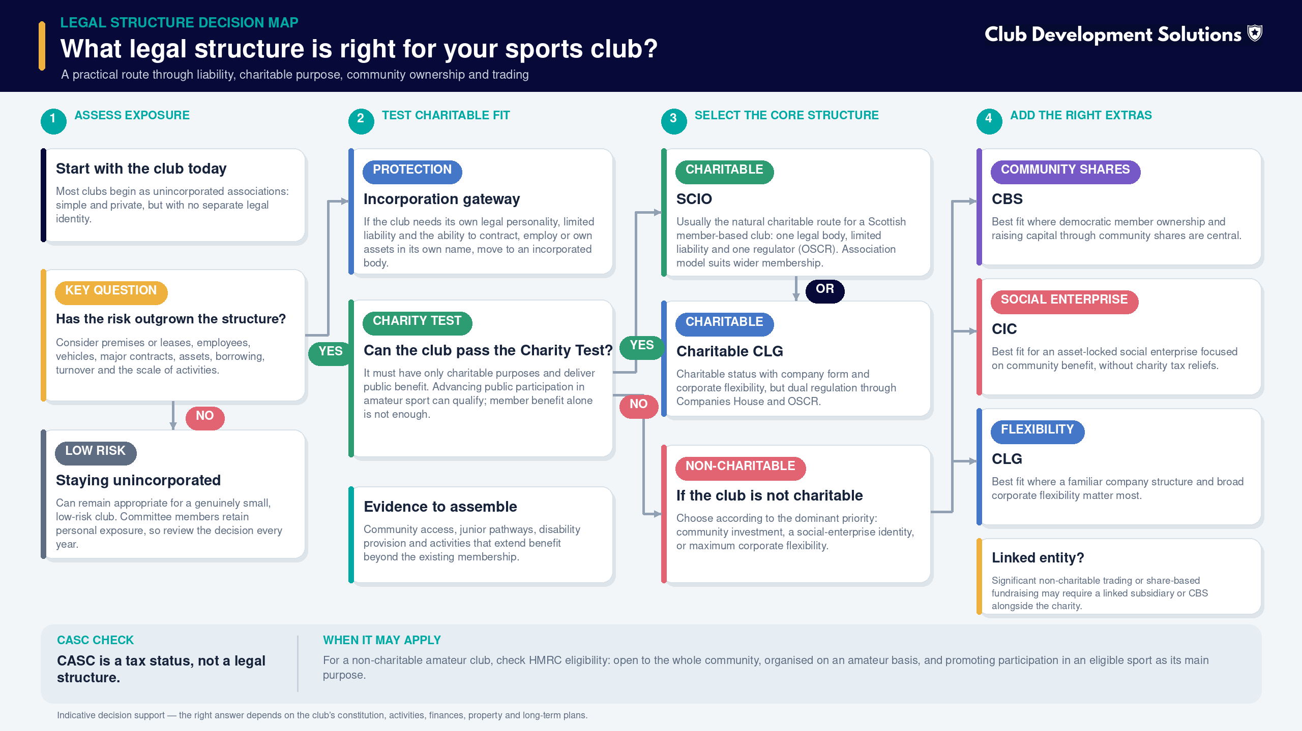
DECISION SUPPORT
What Legal Structure Is Right For Your Club?
SCIO for the charitable activity, with a linked CBS for share-based fundraising
Club Development Solutions | Scottish Volleyball
18

Slide 22
03
SCIOs & Charitable Status
Club Development Solutions | Scottish Volleyball
19

Slide 23

THE HEADLINE STRUCTURE
What Is a SCIO?
A Scottish Charitable Incorporated Organisation combines incorporation and charitable status in a single legal body
Established by the Charities and Trustee Investment (Scotland) Act 2005, but only became available from 1 April 2011 once the supporting regulations came into force, with numbers growing steadily since
A corporate body in its own right, able to enter contracts, employ staff, incur debts, own property, and sue or be sued
Regulated by a single body, OSCR, giving one set of accounts and one annual return, unlike a charitable CLG which answers to both Companies House and OSCR
Trustees enjoy a high degree of protection from personal liability, provided the SCIO operates within its constitution (and legally)
Trade-off: limited flexibility for trading outside the charity's core purposes, a trading subsidiary is usually needed for significant commercial activity
Club Development Solutions | Scottish Volleyball
20

Slide 24
THE GATEWAY
The Charity Test
The two-part test
In practice, for most clubs
The organisation must have only charitable purposes
  The advancement of amateur sport / public participation in sport is a recognised charitable purpose
  Elite or semi-professional activity (e.g. paying players) can put charitable status out of reach
The organisation must provide public benefit in achieving those purposes
Most clubs don't need to reinvent themselves, usually the constitution needs amending to align with charitable purposes and OSCR's requirements
Membership benefit alone isn't enough, the club needs to show wider public benefit (e.g. junior pathways, community access, disability provision)
OSCR assesses each application individually and in detail, vague applications are the most common reason for delay or refusal
Club Development Solutions | Scottish Volleyball
21

Slide 25
BEYOND TAX RELIEF
Advantages of Charitable Status
Tax relief, properly structured, a charity can avoid liability to tax on profits, and can claim Gift Aid on qualifying donations
Rates relief, mandatory 80% relief from business rates, with a further 20% discretionary relief available from the local authority
Public perception and trust, people, funders and partners often view a charity differently to an unincorporated club
Fundraising access, many funders and trusts only accept applications from registered charities; charitable status opens doors that stay closed otherwise
Credibility with landlords, local authorities and community asset transfer processes, incorporated, charitable clubs are seen as more stable partners
Club Development Solutions | Scottish Volleyball
22

Slide 26
BEYOND TAX: THE EXTRA BENEFITS
Charitable Status Unlocks More Than You'd Think
£7,500
25p
80%
£1000s
Free Google advertising per month available through Google for Nonprofits
Extra for every £1 donated, reclaimed automatically through Gift Aid
Mandatory business rates relief, with up to 20% more at local authority discretion
Typical annual savings available through charity discount and licensing platforms
We help clubs set up Google for Nonprofits (incl. Ad Grants management), Microsoft for Nonprofits, and access charity discount platforms such as Goodstack, Charity Digital Exchange and Charity Worker Discounts, capacity-building that costs nothing but admin time.
Club Development Solutions | Scottish Volleyball
23

Slide 27
FREE & DISCOUNTED SOFTWARE
Google, Microsoft & Goodstack
Google & Microsoft for Nonprofits
Goodstack: One Verification, Dozens of Discounts
Google for Nonprofits gives eligible charities up to £7,500 a month in free Google Ad Grants search advertising, plus discounted Google Workspace and free YouTube perks
Microsoft for Nonprofits offers free and heavily discounted Microsoft 365 licences, Azure credits and Teams, worth thousands a year for a typical club
Both require charitable status (or CASC/registered nonprofit status) and a short verification step, usually completed through Goodstack
Goodstack is the nonprofit verification platform behind most of these offers. Verify your charity once and it unlocks discount programmes across dozens of partner companies
Partners include Asana (50% off), Canva (free Canva for Nonprofits), monday.com, Docusign (30 to 50% off) and Adobe Acrobat, alongside Google's and Microsoft's own programmes
Free to register, and most discounts run from 30% to 100% off standard pricing, real savings for a volunteer-run committee juggling software costs
Club Development Solutions | Scottish Volleyball
23

Slide 28
FUNDRAISING & FREE EXPERT SUPPORT
JustGiving & Cranfield Trust
JustGiving for Clubs
Cranfield Trust: Free Pro Bono Consultancy
Free to join on the Start plan, no monthly fee. You pay standard payment processing (1.9% plus 20p per donation) and an optional 5% fee only if you use JustGiving's automated Gift Aid claim service
You'll need a charity registration number or an HMRC Gift Aid number to sign up, so this becomes available once your SCIO or CASC status comes through
Handles Gift Aid administration automatically for eligible donations, cutting down the manual declaration-chasing covered earlier in this section
The UK's leading provider of free management consultancy for charities, matching you with an experienced volunteer consultant on governance, strategy, financial management or people issues
Genuinely free. You only cover the volunteer's reasonable expenses, the service itself is funded by trusts, foundations and corporate donors
Worth checking first: eligibility leans towards organisations whose primary purpose addresses human welfare (poverty, disability, social exclusion), and generally expects a first set of published accounts already in place
Club Development Solutions | Scottish Volleyball
24

Slide 29

The Trade-Offs of Charitable Status
Administration, regulation by OSCR brings ongoing administrative burden, covered in the next section
Constraint, charitable status can restrict activities that sit outside the charity's stated purposes; trading beyond this can put status at risk
Reversibility, if a SCIO loses its charitable status, it ceases to exist as a legal entity altogether (unlike other structures, which simply lose a tax status)
This isn't a reason to avoid charitable status, but committees should go in with eyes open about what "proper" governance now requires
Club Development Solutions | Scottish Volleyball
27

Slide 30
04
Governance & Compliance
What running a SCIO properly actually looks like, year to year.
Club Development Solutions | Scottish Volleyball
28

Slide 31
TRUSTEE DUTIES
Your Duties as a Charity Trustee
Act in the charity's interest
Operate within your purpose
Do what is best for the charity and its beneficiaries, not what suits you, your friends, family or other organisations you're involved with
Maintain a register of trustees' affiliations to flag potential conflicts early
Have a clear policy on when payments to trustees or connected people are permissible (reasonable expenses are fine; payment for services usually isn't, without specific provision)
Every charity has a governing document setting out its purpose and how it operates, everything the club does must sit within it
New trustees should get an induction pack including a copy of the governing document
Review the governing document regularly to keep it current and relevant to what the club actually does
Club Development Solutions | Scottish Volleyball
29

Slide 32
TRUSTEE DUTIES
Acting With Care, Diligence & Avoiding Conflicts
Care & diligence
Managing conflicts of interest
Run the charity responsibly and collaboratively, for its benefit
Comply with relevant law, health & safety, data protection, employment
Ensure sufficient funds exist to meet staff costs and other obligations
Protect the charity's name, registration number and logo from unauthorised use
Seek legal or financial advice when it's needed, and know when that is
A conflict exists when your duty to the charity conflicts with the interest of whoever appointed you, or with your own personal/business interests
Identify: make conflicts a standing agenda item at trustee meetings
Manage: use a conflict of interest policy, the conflicted trustee withdraws from that part of the meeting
Record: keep a written record of the situation and what was done about it
Club Development Solutions | Scottish Volleyball
30

Slide 33
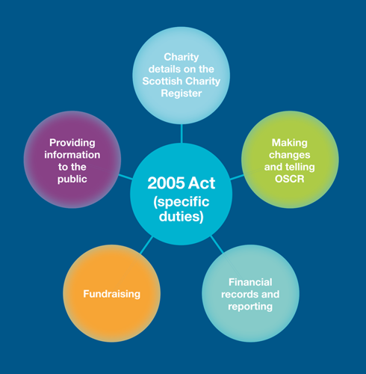
THE LEGAL BASELINE
Complying with the 2005 Act
Charity details on the Scottish Charity Register, kept accurate and up to date at all times
Making changes & telling OSCR, permission is needed before changing the charity's name, its purposes, or winding it up
Financial records & reporting, accounting records covering income, expenditure, assets and liabilities must be kept
Fundraising, anyone raising funds on the charity's behalf must comply with the Code of Fundraising Practice
Providing information to the public, the charity number appears on formal communications; governing documents and accounts are available on request
Club Development Solutions | Scottish Volleyball
31

Slide 34
REPORTING
What OSCR Needs From You, Every Year
4
9mo
6yr
3
Documents due annually: accounts, Trustees' Annual Report, external scrutiny report, online annual return
Deadline to submit after your financial year end, miss it and your register entry is marked as late
Minimum period accounting records must be retained
Total individuals who can be given access to submit on OSCR Online (principal contact + two more)
First period of accounts: must start from the SCIO's registration date, and can run for anywhere between 6 and 18 months. If a body existed before the SCIO, any assets transferred in must be shown as a donation in that first set of accounts.
Club Development Solutions | Scottish Volleyball
32

Slide 35
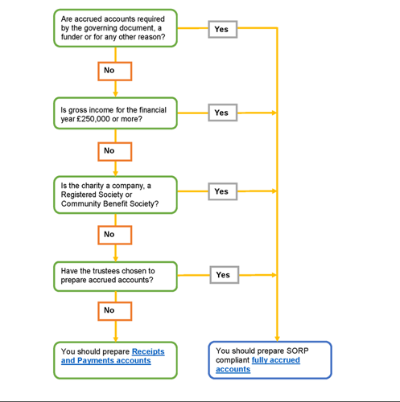
REPORTING
(1) The Trustees' Annual Report, What It Must Cover
Reference & administration details, charity name, registered number, principal address, and a full list of trustees who served during the year (with dates, if not for the full period)
Structure, governance & management, type of governing document, and how trustees are recruited and appointed
Objectives & activities, the charity's purposes, and a summary of the main activities carried out to achieve them
Achievements & performance, a summary of the charity's main achievements during the financial period
Financial review, a statement of reserves policy, details of any deficit, and any donated facilities or services received
Declaration, signed on behalf of the trustees confirming the report has been approved (OSCR accepts digital or typed signatures)
Club Development Solutions | Scottish Volleyball
33

Slide 36
COMPLIANCE
(2) Annual Accounts & (3) External Scrutiny
Annual accounts
External scrutiny: audit vs. independent examination
Receipts and Payments accounts for smaller charities, or Fully Accrued accounts above certain income thresholds
Set out across unrestricted, restricted, and endowment funds where these exist
Must reconcile with the accounting records kept throughout the year
Audit, required where your governing document specifically uses the word "audit", or above certain income thresholds; carried out by a registered auditor
Independent examination, a lighter-touch review carried out by someone independent of the charity's management, with the relevant skills and experience
Most small-to-medium SCIOs use independent examination rather than a full audit
Club Development Solutions | Scottish Volleyball
34

Slide 37
DECISION SUPPORT
Audit or Independent Examination? (OSCR's Test)
Is an audit required by your governing document, another enactment, a funder, or for any other reason?
Audit by a registered auditor
YES
NO
Is gross income for the financial year £1,000,000 or more? (£500,000 for periods starting before 1 January 2026)
YES
NO
Do gross assets at the year end exceed £3,260,000?
YES
Have accrued accounts been prepared?
YES
NO
Have the trustees chosen to have the charity's accounts audited?
YES
NO
Does the charity prepare fully accrued accounts?
YES
NO
Independent examination by a member of a listed professional body
NO
Independent examination by an appropriate person
Gross assets means fixed assets plus current assets, before deducting liabilities. "Accrued accounts" (fully accrued/SORP-compliant accounts) are required once gross income reaches £250,000. Further rises to these thresholds are expected later in 2026, check OSCR's current guidance closer to your charity's year end.
Club Development Solutions | Scottish Volleyball
36

Slide 38
COMPLIANCE
(4) The Online Annual Return
Submitted through OSCR Online, alongside your accounts and Trustees' Annual Report
Typical questions include: financial year-end date, number of trustees and paid staff, number of volunteers, gross income and expenditure, and whether the charity owns land or buildings
Also covers governance questions: was the governing document reviewed or changed this year; is there an up-to-date trustee induction process; do any trustees receive payment for services
Some of this information becomes publicly visible on the Scottish Charity Register, sensitive details are redacted, but transparency is the underlying principle throughout
Good news: most of this is simply good record-keeping done consistently through the year, not a last-minute scramble in month nine.
Club Development Solutions | Scottish Volleyball
35

Slide 39
BRINGING IT TOGETHER
10 Key Points to Running a Charity Properly (1/2)
1-3
4-5
Prioritise your charity's interests: your legal responsibility as a trustee is to put the charity first. Trustees are collectively responsible for managing it ethically and lawfully
Act with care and diligence: protect the charity's beneficiaries, assets and reputation by operating with caution and diligence at all times
Understand your legal responsibilities: compliance with charity law and other relevant legislation is vital to the charity's credibility and its ability to keep operating
Manage conflicts of interest: identify, declare and manage any conflicts, always putting the charity's needs first
Know your charitable purposes: every activity should align with, and work towards, the goals set out in the charity's governing document
Club Development Solutions | Scottish Volleyball
36

Slide 40
BRINGING IT TOGETHER
10 Key Points to Running a Charity Properly (2/2)
6-8
9-10
Keep a copy of the governing document to hand: it sets out your responsibilities, powers and limitations as a trustee
Understand the charity's finances: trustees are jointly responsible for financial management, so make sure you can access and understand the records
Submit required reports to OSCR on time: accounts, Trustees' Annual Report, external scrutiny report and online annual return, every year
Keep charity details up to date on the Scottish Charity Register via OSCR Online, and remember some changes need OSCR's permission first
Publicise your charity's status: display your charity number publicly to reinforce trust and transparency with members, funders and the public
Club Development Solutions | Scottish Volleyball
37

Slide 41
QUICK-FIRE · QUESTION 3
Your SCIO's financial year ended on 31 March. By what date must your accounts, Trustees' Annual Report, external scrutiny report and annual return all be with OSCR?
30 April (1 month)
A
30 June (3 months)
B
31 September (6 months)
C
31 December (9 months)
D
Club Development Solutions | Scottish Volleyball
38

Slide 42
QUICK-FIRE · QUESTION 3
Your SCIO's financial year ended on 31 March. By what date must your accounts, Trustees' Annual Report, external scrutiny report and annual return all be with OSCR?
30 April (1 month)
A
30 June (3 months)
B
31 September (6 months)
C
31 December (9 months)
D
Nine months after the financial year end, miss it, and your charity's register entry is marked as late, which funders and the public can see.
Club Development Solutions | Scottish Volleyball
38

Slide 43
05
Becoming a SCIO
What the incorporation journey actually looks like, step by step.
Club Development Solutions | Scottish Volleyball
39

Slide 44
THE JOURNEY
The SCIO Incorporation Timeline
1
2
3
4
5
6
7
8
Decide the model
Appoint trustees
Draft the constitution
Apply to OSCR
Decision & registration
Transfer & wind up
Register for Gift Aid
Ongoing compliance
Choose the 'association' model (wider membership, votes at AGM), the natural fit for most member-based clubs, over the narrower 'foundation' model.
Identify who will be the charity trustees. OSCR expects a minimum of 2–3, for transparency and good governance.
Drafted to meet OSCR's charity law requirements while reflecting how your club actually wants to run.
A detailed application against the Charity Test, vague answers are the most common cause of delay.
OSCR reviews on an individual basis; once approved, the SCIO is registered and becomes a legal entity.
Assets and liabilities transfer from the old club to the SCIO; the old unincorporated body is formally wound up per its constitution.
Apply to HMRC once charitable status is confirmed, registration typically takes around 6 weeks to process.
Annual accounts, Trustees' Annual Report, external scrutiny and annual return become part of the club's yearly rhythm.
Club Development Solutions | Scottish Volleyball
40

Slide 45
RECAP
Learning Outcomes Reviewed
You can now explain the difference between unincorporated and incorporated clubs, and the liability risk that sits behind that choice
You can compare CLG, CBS, CIC, SCIO and CASC, and reason about which best fits your club's situation
You understand the Charity Test, Gift Aid, and the wider practical benefits charitable status unlocks
You know what running a SCIO properly requires, trustee duties, the four annual OSCR submissions, and the 9-month deadline
You have a clear picture of the incorporation journey and what we'll need from you to get started
Club Development Solutions | Scottish Volleyball
42

Slide 46
OVER TO YOU
Questions for Discussion
Is your club currently unincorporated, and if so, has your committee ever formally discussed the personal liability risk?
Where do you think your club sits against the Charity Test, would advancing participation in volleyball, and public benefit, be straightforward to evidence?
Who currently holds the "corporate memory" of your governing documents, and when were they last reviewed?
What would need to be true for your committee to commit to starting this process in the next 12 months?
Club Development Solutions | Scottish Volleyball
43

Slide 47
LET'S KEEP WORKING TOGETHER
How We Can Help Your Club
Incorporation & charitable status (SCIO, CIC, CBS, CASC)
Google for Nonprofits setup and Ad Grants management
Funding, grant applications and grant-readiness support
Gift Aid registration and maximisation
Training and workshops for committees and volunteers
GET IN TOUCH
Email
andrew@clubdevelopmentsolutions.com
Phone
07769 175 480
Web
www.clubdevelopmentsolutions.com
Instagram / Facebook
@clubdevelopmentsolutions
LinkedIn
Club Development Solutions

