Slide 1



FUNDING
A workshop for Volleyball Clubs
X
Delivered for Scottish Volleyball
Presented by Dr Andrew Jenkin, Club Development Solutions

Slide 2

ABOUT US
Club Development Solutions
We've led the incorporation of 50+ sports clubs across the UK into charitable and community structures.
Helped clubs raise £400,000+ in grants and £6 million+ through community shares.
We deliver ongoing governance and funding support in partnership with Scottish Athletics, Scottish Golf, Basketball Scotland and Scottish Swimming.
Governing Body Partners
Clubs We Support Directly
Scottish Athletics · Scottish Golf · Scottish Swimming
Basketball Scotland · Scottish Gymnastics
Athena Glasgow · Coventry Community Sports Hub
Grangemouth Community Sports Hub · Zenkai Judo Club
"They've built a genuine understanding of how clubs actually operate, their voluntary nature, funding pressures, and different appetite for change from one committee to the next."
Colin Hutchison, CEO, Scottish Athletics
Club Development Solutions | Scottish Volleyball
1

Slide 3
TODAY'S SESSION
By the End of Today, You Will Be Able To…
Understand the funding landscape in Scotland, and where volleyball clubs realistically fit within it
Build a clear case for support covering your organisation, the need, your solution, its impact and its sustainability
Write stronger funding applications, and understand what a funder actually does with your application once you submit it
Recognise what builds (and damages) your credibility with funders, and why governance and charitable status matter here too
Know the specific platforms and funders worth exploring first, and claim every pound of Gift Aid you're entitled to, including the tricks most clubs miss
Understand how to use AI sensibly to support (not replace) your funding work
Club Development Solutions | Scottish Volleyball
2

Slide 4

01
The Funding Landscape
Understanding who funds what, before you write a single application.
Club Development Solutions | Scottish Volleyball
3

Slide 5
WHO'S ACTUALLY OUT THERE
The Funding Sector in Scotland
Independent trusts and foundations, the largest and most varied category, each with its own priorities, geography and application process
Lottery funders, including the National Lottery Community Fund and National Lottery Awards for All Scotland
Statutory funders, local authorities, sportscotland and Scottish Government programmes
Individual philanthropists and major donors, often reached through relationships rather than open applications
Social investors, offering loans or repayable finance rather than grants, usually for capital projects or income-generating activity
Club Development Solutions | Scottish Volleyball
4

Slide 6
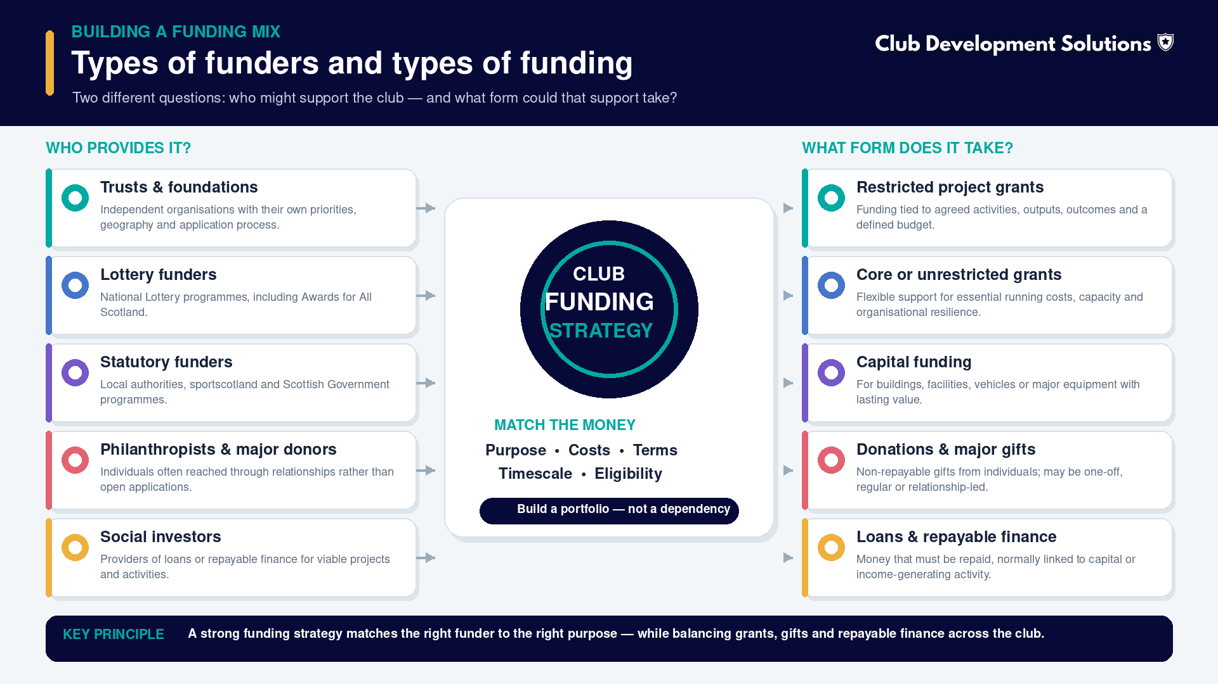

Slide 7
THE LINK BACK
Why Your Legal Structure Changes Your Funding Options
What charitable status opens up
Credibility funders look for
Many trusts and foundations only accept applications from registered charities. As a SCIO or a charity, doors open that stay closed to unincorporated clubs
Gift Aid stacks on top of grant income: 25p extra for every £1 in eligible donations, at no extra cost to the donor
Rates relief (80% mandatory, up to 100% with local discretion) frees up budget that would otherwise go straight to overheads
A registered charity number, published accounts and a proper governing document all signal you can be trusted with public money
Funders check your annual accounts and governing documents to confirm you can actually deliver what you're proposing
Covered in our Legal Structures & Charitable Status session, incorporation and governance aren't just protection, they're part of your funding strategy
Club Development Solutions | Scottish Volleyball
5

Slide 8
"
Often overlooked is the way in which the club is set up legally, and the impact that this may have on the financial and legal position of the club.
On why legal structure and funding success are more connected than clubs think
Club Development Solutions | Scottish Volleyball
6

Slide 9
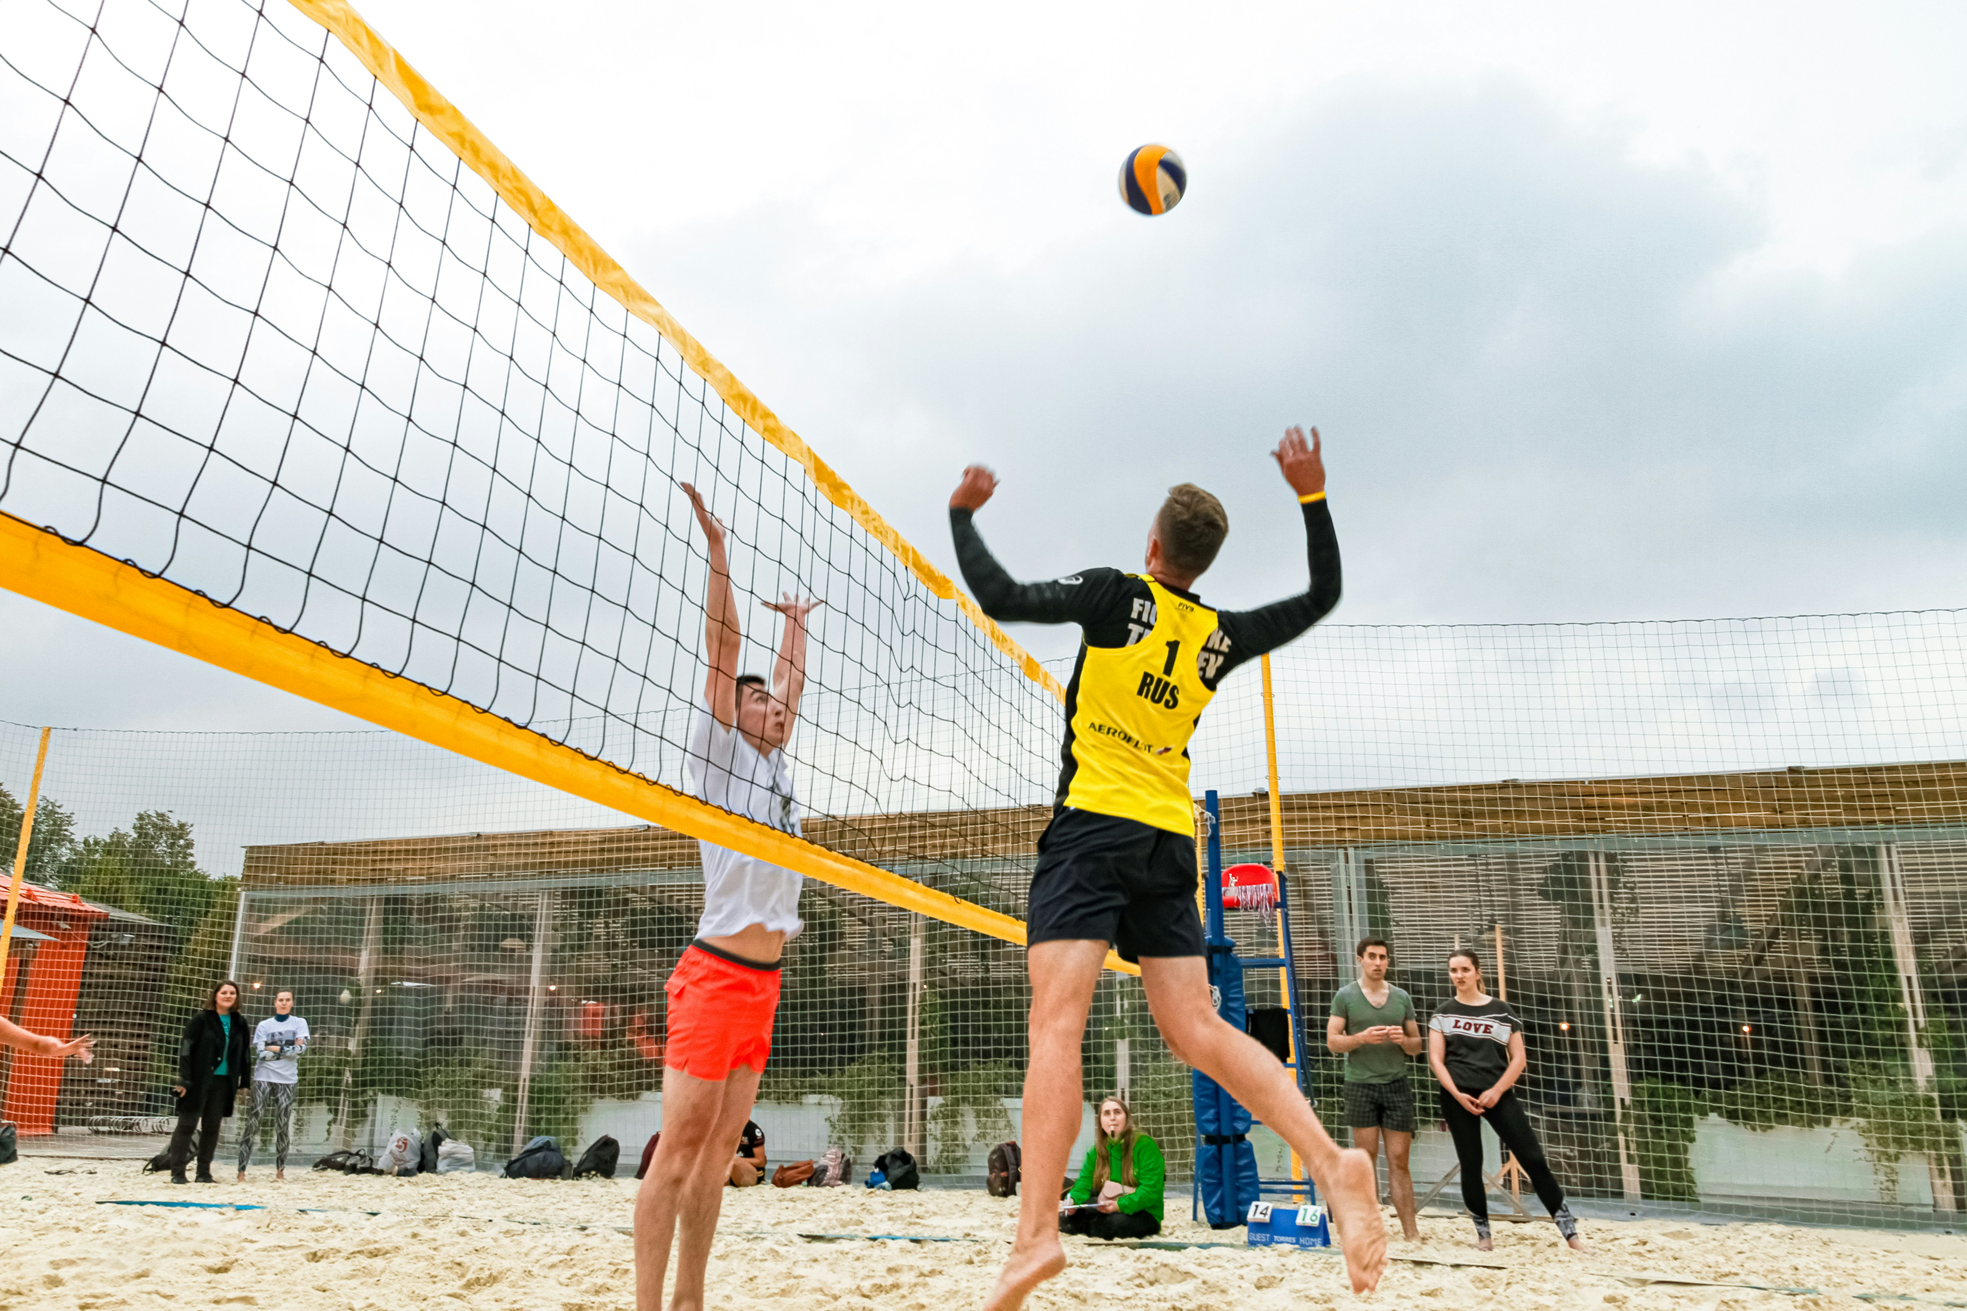
02
Your Case for Support
The single document that makes every funding application after it easier to write.
Club Development Solutions | Scottish Volleyball
7

Slide 10
THE FOUNDATION DOCUMENT
What Is a Case for Support?
A detailed document containing most of the information you'll need across every funding application you write
Have one for your organisation as a whole, and one for each major funding priority or project
It positions your club as a credible authority on the issue you address, genuinely engaged with the people you support
At its best, it explains how things have changed for your members and community, how your club has adapted, and what the future holds
Five components: Organisation, Need, Solution, Impact, Sustainability, we'll work through each in turn
Club Development Solutions | Scottish Volleyball
8

Slide 11
COMPONENT 1 OF 5
Organisation
Questions to answer
Don't forget
When was your club established? By whom, and why?
What is your vision and mission?
Why is your club best placed to deliver this work?
What is your track record and experience?
Who leads your club, and who are your partners? How do you work together?
How do your members and beneficiaries contribute to, or help run, the club?
What is your financial position, income, expenditure and reserves, in plain terms?
Club Development Solutions | Scottish Volleyball
9

Slide 12
COMPONENT 2 OF 5
Need
Questions to answer
Evidencing the need
What problem or problems are you working to address?
What are the implications of this problem for your members and community?
Who identified this problem, and how can you prove it?
Is anyone else already trying to fix it? What would happen if your club didn't act?
Relying only on secondary data (national or regional statistics) is often less persuasive than your own evidence
Build your own evidence through surveys, interviews, discussion groups, a waiting list of interested participants, partner meetings, letters of support and case studies
The more specific and local your evidence, the more credible your case
Club Development Solutions | Scottish Volleyball
10

Slide 13
COMPONENT 3 OF 5
Solution
What & why
What makes it different
What is your solution to the problem you've identified? Describe the project and how it directly addresses the need
Highlight the specific activities, services or resources you'll provide
Why is your solution effective? Show evidence of previous success, similar projects, testimonials or case studies
What makes your solution unique? Emphasise innovation, local expertise or a tailored approach
Demonstrate how your project is distinct from, or better suited than, other interventions addressing the same need
Funders fund solutions, not just good intentions, be concrete
Club Development Solutions | Scottish Volleyball
11

Slide 14
COMPONENT 4 OF 5
Impact
Difference & reach
Wider benefits & measurement
What difference will your project make? Outline short, medium and long-term outcomes with clear, measurable targets
For example: "We aim to engage 500 young people in physical activity within 12 months"
Who benefits, and what is the scale and reach of that impact?
What are the ripple effects? Improved health, community cohesion, employability, reduced inequality
Connect your work to local, regional or national priorities like public health or community development
How will you measure success? Describe your KPIs, monitoring tools and reporting process
Club Development Solutions | Scottish Volleyball
12

Slide 15
COMPONENT 5 OF 5
Sustainability
How will the project continue beyond this funding? Outline plans to diversify income, grants, sponsorship, events, membership fees
What self-sustaining revenue could this create, fees for services, facilities hire, merchandise?
What partnerships will support sustainability, and who brings expertise, resources or ongoing funding?
How will the project build long-term capacity, through staff training, volunteer development or community ownership?
What legacy will it leave, improved skills, better facilities, lasting behaviour change?
Club Development Solutions | Scottish Volleyball
13

Slide 16
WORKED EXAMPLE
Think Like a Volleyball Club, and Don't
TOO NARROW, JUST VOLLEYBALL
"Riverside Volleyball Club is seeking funding for new nets, a ball machine and coach travel costs so we can run more training sessions for our senior league squad."
BROADER, WHAT VOLLEYBALL ACTUALLY DOES
"Riverside Volleyball Club uses volleyball to tackle physical inactivity and social isolation among young people and adults in Riverside, with a particular focus on girls and women who drop out of sport in their teens. New nets, a ball machine and coach travel let us run two additional weekly sessions, reaching 40 more participants and building a pathway from taster sessions into regular, lifelong activity."
Use examples from other sports and clubs who've broadened their story well, you're not the first to make this case
You reach people and communities many other organisations simply can't, that's a genuine asset, use it
Broadening your story is great, but never let it come at the cost of actually delivering brilliant volleyball underneath it
Club Development Solutions | Scottish Volleyball
14

Slide 17

03
Writing a Winning Application
What funders actually look for, and what happens to your application after you press submit.
Club Development Solutions | Scottish Volleyball
15

Slide 18
START HERE, NOT THERE
Planning Your Application
Start with why your project is needed, what problem is being solved, and who needs it. Not what your project needs
Check you're eligible before you invest hours in an application, and call the funder to talk through your idea first if that's an option
Once you understand the need, explore: the extent of the problem, its causes, who else is doing what, why nobody else is doing it in your area, and who can help you
Understanding the need properly helps you define your outcomes, plan your activities, judge the right scale of work, and explain to others why the project matters
Club Development Solutions | Scottish Volleyball
16

Slide 19
THE CHECKLIST
What Makes a Good Funding Application?
Completed in full, signed and dated, with everything the funder asked for provided
Provides credible evidence of need, and meets the funder's eligibility criteria
Well written, clear, with no spelling mistakes, and answers every question in full
The budget adds up and aligns with your activities (a clear line of sight between the two)
Your annual accounts and governing documents confirm you can actually deliver what you're proposing
Doesn't assume the funder or assessor already knows anything about you or your work
Club Development Solutions | Scottish Volleyball
17

Slide 20
HOW COULD WE IMPROVE THIS?
Understanding the Funder's Priorities
WEAKER
"Drumchapel Sports Cycle Club wants funding for 50 bikes, storage and coaching to provide a weekly cycling club in Drumchapel."
STRONGER
"Drumchapel Sports Cycle Club aims to improve the wellbeing of inactive older people in Drumchapel. It will offer weekly cycling opportunities and bike rides across the local area. We require funding for 50 bikes, storage and coaching."
The stronger version leads with the change it creates. The weaker one leads with a shopping list.
Club Development Solutions | Scottish Volleyball
18

Slide 21
BEHIND THE SCENES
What Funders Do With Your Application
1
2
3
4
5
6
7
Process starts
Completeness check
Eligibility check
Criteria fit
Outcomes fit
Score & rank
Decision
Your application enters the funder's system and is logged.
Have you answered everything and provided every document asked for?
Does your club and project actually qualify for this fund?
Does your application fit the fund's stated criteria?
Do your outcomes align with what the funder is trying to achieve?
Your application is scored and ranked against every other applicant.
A funding decision is made, usually within a stated timeframe.
Club Development Solutions | Scottish Volleyball
19

Slide 22
THE QUESTION BEHIND THE QUESTION
Bid Credibility
"Do we trust you enough to give you a grant?"
"Do we believe you can deliver this project?"
This is about financial risk and reputational risk to the funder
It matters most with core funders and capital funders, where the money underwrites your whole organisation, not just one project
This is about the risk of outcomes not being achieved, and the reputational risk that follows
It matters most with project funders, who are backing a specific, time-limited piece of work
Club Development Solutions | Scottish Volleyball
20

Slide 23
BUILDING IT DELIBERATELY
What Impacts on Credibility?
What damages it
What builds it, year-round
Being a new or small organisation, or showing financial instability
Negative media coverage, or a negative experience with a previous funder
Overdue reporting or late accounts with OSCR or Companies House
Poor financial monitoring on a previous grant
Resolving any of the negatives above, proactively, before a funder finds them
Strong stewardship and grant reporting on every award you receive
Being up to date with regulator reporting (OSCR, Companies House)
An active online presence, recognised awards, and genuine partnerships
Club Development Solutions | Scottish Volleyball
21

Slide 24
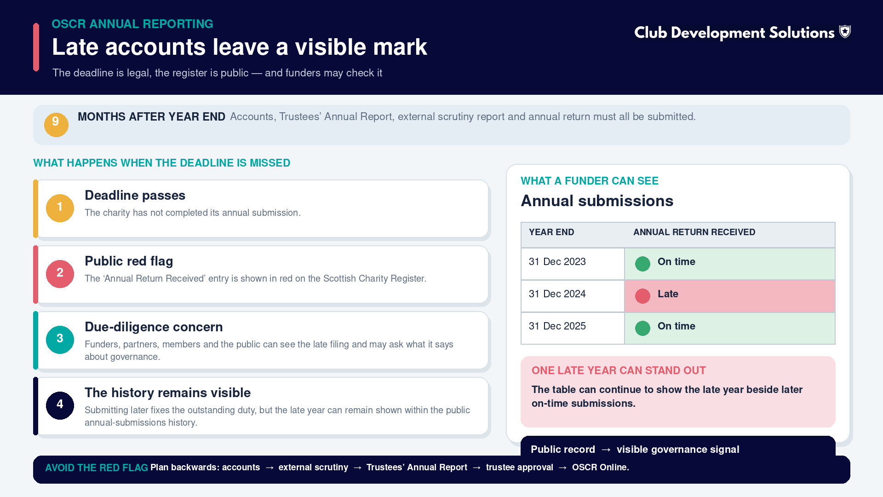

Slide 25
04
Funding Your Core Costs
Not every funder will pay for a project. Some will keep the lights on.
Club Development Solutions | Scottish Volleyball
22

Slide 26
THE COSTS EVERYONE FORGETS
What Are Core Costs?
The essentials, running or not
Funders known to support core costs
Core costs are the ongoing expenses that keep your club operational, whether or not a specific project or programme is running
Overheads, management and administration
Insurance, rent and utilities
Marketing, fundraising and non-delivery staffing
Garfield Weston Foundation, Lloyds Bank Foundation, Esmée Fairbairn Foundation
Albert Hunt Trust, The Fore, Trusthouse Charitable Trust
Yapp Charitable Trust, The Allen Lane Foundation, Woodward Charitable Trust
Most are trust and foundation funders, so a strong case for support and clean governance matter even more here
Club Development Solutions | Scottish Volleyball
23

Slide 27

05
Where to Find Funding
The platforms and funders worth knowing, specifically for volleyball and grassroots sports clubs.
Club Development Solutions | Scottish Volleyball
24

Slide 28

START HERE
Funding Scotland
What it is
Why it's worth ten minutes
SCVO's free online funding search, covering over 1,200 funding opportunities: trusts, lottery, statutory funds and more
Free to use for any organisation in Scotland, no membership required to search
SCVO members and supporters get Funding Scotland Premium: saved searches, personalised email alerts and downloadable fund reports
It's usually the fastest way to see what's currently open and relevant to your club, rather than searching individual funder websites one by one
Filter by geography, sport, and the type of activity you deliver
Pair it with SCVO's funding guide for tips on applications and fundraising planning
Visit funding.scot
Club Development Solutions | Scottish Volleyball
25

Slide 29

FOR SMALL, FAST GRANTS
ActionFunder
How it works
What to expect
A free platform that matches community groups with businesses and foundations wanting to fund local causes
Create one project profile, get matched automatically to relevant open funds, no charity status required
Open to sports clubs, CICs, SCIOs, informal volunteer groups and more
Most funders on the platform support projects of £3,000 to £5,000, with a cap of £10,000
You can run multiple project pitches at once for different needs (equipment, coaching, a specific initiative)
Completely free for community groups to use
Visit actionfunder.org
Club Development Solutions | Scottish Volleyball
26

Slide 30

FOR SMALL GRASSROOTS GRANTS
Cash4Clubs
The essentials
Worth checking before you apply
Funded by Flutter UK & Ireland, delivered by the charity Sported. Unrestricted grants of £2,000 (€2,000 in Ireland) per club
Can be used for facilities, equipment, coaching qualifications or general sustainability, whatever your club needs most
Currently open from 1 October 2026 to 1 January 2027
The current round is adults-only (18+): clubs with junior members or junior activities are not eligible for this round
Priority goes to clubs working in areas of high deprivation, and engaging under-represented groups (women, disabled people, LGBTQ+ people, racially diverse communities)
One application per club, and delivered through Sported, worth being a member first (next slide)
Visit sported.org.uk/cash4clubs
Club Development Solutions | Scottish Volleyball
27

Slide 31

MEMBERSHIP THAT PAYS FOR ITSELF
Sported
What membership gets you
Why it opens up funding
Free to join, takes minutes. The UK's largest charity supporting grassroots sport, with a network of over 5,000 groups
Access to funding pots and hands-on support with funding applications
Free pro bono consultancy on fundraising, governance, HR and business planning
Monthly funding bulletins flagging what's currently open and relevant
Several corporate funds, including Cash4Clubs (Flutter) and the Barclays Community Sport Fund, are delivered exclusively through Sported's member network
Being a member is often the route in, not just a nice-to-have, some funding simply isn't open to non-members
Eligibility is broad: UK-based, constituted, non-profit or profit-for-public-good, delivering sport or physical activity to any age
Visit sported.org.uk
Club Development Solutions | Scottish Volleyball
28

Slide 32

FOR SCOTTISH CLUBS SPECIFICALLY
Aldi Sports Fund
The Scottish Sports Fund
The wider Aldi Sports Fund
Now in its 10th year, awarded over £500,000 to more than 650 grassroots clubs since 2016
Applications open on a rolling basis by region and postcode area throughout the year, typical awards range from £500 to £2,500
Volleyball clubs have been funded through this scheme before, it's genuinely open to any sport
Now expanded to England and Wales too, with grants of up to £3,000 for equipment, kit, coaching and facility hire
Selected Gold-tier recipients get the chance to meet a Team GB or ParalympicsGB athlete
Check your region's specific application window before applying
Visit aldi.co.uk/scottishsportfund
Club Development Solutions | Scottish Volleyball
29

Slide 33
A TIMELY ONE
National Lottery Awards for All Scotland
£300–£10k
£2.2m
Up to £10k
Rolling
Standard grant range for community, arts and sports projects
Extra funding announced for Glasgow 2026 Commonwealth Games-inspired projects
Available for Games-inspired projects lasting up to 12 months
Applications accepted year-round, no fixed deadline
Delivered in partnership with sportscotland and Creative Scotland. With the Commonwealth Games returning to Glasgow, a volleyball club running Games-inspired community activity has a genuinely timely, well-funded route in right now.
Club Development Solutions | Scottish Volleyball
30

Slide 34
ONCE YOU'RE READY TO GO BIGGER
The UK's Biggest Grantmaking Foundations
Rank | Foundation | Annual Giving | Why It's Worth Knowing
#7 | Garfield Weston Foundation | £89m | UK-wide, general charitable purposes, simple application process
#9 | Henry Smith Charity | £65m | UK-wide, focused on disadvantage and inequality
#10 | BBC Children in Need | £62m | UK-wide, children and young people's wellbeing
#19 | Corra Foundation | £45m | Scotland-specific, community and social justice
#20 | Paul Hamlyn Foundation | £40m | UK-wide, education, arts and social justice
#22 | Wolfson Foundation | £38m | UK-wide, strong capital and buildings focus
#24 | Esmée Fairbairn Foundation | £37m | UK-wide, community and social change, also funds core costs
#41 | Foundation Scotland | £23m | Scotland-specific, manages many local and regional funds
#51 | The Robertson Trust | £19m | Scotland-specific, one of the largest funders in the country
#62-74 | The Postcode Trusts | £14-15m each | Funded by People's Postcode Lottery, Edinburgh-based, strong Scottish reach
Data: UKGrantmaking & 360Giving, via Kevin L. Brown's Top 100 UK Donors analysis (CC BY 4.0)
Club Development Solutions | Scottish Volleyball
31

Slide 35
READING THE LIST
How to Actually Use a List Like This
These are large, well-resourced trusts, expect real competition and a proper case for support (covered earlier) before you apply
Scotland-specific funders (Corra Foundation, Foundation Scotland, The Robertson Trust) are worth prioritising, they understand the Scottish funding landscape and often fund at a scale smaller trusts can't
The Postcode Trusts are a family of funds from People's Postcode Lottery, headquartered in Edinburgh, with a strong track record of funding small and medium Scottish community groups
Cross-reference this list against Funding Scotland to confirm which of these are currently open and matched to your club's size and activity
Club Development Solutions | Scottish Volleyball
32

Slide 36
MORE WORTH KNOWING
Other Platforms & Funders for Clubs
Platform | What It Does | Cost to Your Club
GoodBox | Contactless donation boxes for club premises, events and matchdays | Device cost or subscription, check current pricing
Work For Good | Makes it simple for local businesses to give a share of sales to your club | Free to join as a cause
easyfundraising | Supporters raise free donations when shopping online with participating retailers | Free
Get Grants | Grant fundraising consultancy, training and support for smaller charities | Paid consultancy and training
Sported | Charity supporting grassroots sports clubs, runs Cash4Clubs and other funds, plus a free newsletter of open funds | Free to join
JustGiving | Online giving and Gift Aid administration, covered in our Legal Structures session | Free Start plan + processing fees
Club Development Solutions | Scottish Volleyball
33

Slide 37
06
Gift Aid
The free 25p in every £1 most clubs are still leaving on the table.
Club Development Solutions | Scottish Volleyball
35

Slide 38
CLAIMING IT BACK
Gift Aid, The Basics
Available to both CASCs and charities, though what you can claim it on differs between the two
For every £1 donated by a UK taxpayer, your club can claim back 25p from HMRC, so a £1 donation is worth £1.25
The Gift Aid Small Donations Scheme allows claims on cash donations too, up to a set amount per individual, without needing a declaration
A Gift Aid declaration must be completed by the donor and held on file, paper or digital
Registration with HMRC typically takes a few weeks once charitable status is confirmed
Club Development Solutions | Scottish Volleyball
36

Slide 39
THE BIT CLUBS GET WRONG
Gift Aid & Membership Subscriptions
For a membership payment to qualify for Gift Aid, it must be a genuine gift, not a payment in exchange for something
General rule: a payment that secures goods, services, or personal use of facilities is not a qualifying gift
So if a subscription buys personal access to pitches, courts or coaching, it is not eligible for Gift Aid as it stands
It can still qualify where the payment does no more than secure affiliated membership, and doesn't secure personal use of facilities or services
Getting this structure right, sometimes by splitting membership into an affiliation fee plus a separate facilities charge, is one of the most valuable pieces of advice we give clubs
Club Development Solutions | Scottish Volleyball
37

Slide 40
A GENUINELY UNDERUSED TRICK
Gift Aid From Volunteer Expenses
How it actually works
Getting it right
Coaches, committee members and officials often rack up genuine costs, travel to away matches, parking, referee fees, and are entitled to claim them back from the club
If they'd rather not take the money, the tax-efficient route is: the club actually pays the expense claim, then the volunteer gifts that payment straight back as a Gift Aid donation
That donation needs its own Gift Aid declaration, just like any other gift
A simple waiver doesn't count, HMRC requires an actual payment to the volunteer and a genuine gift back, not a decision to never claim in the first place
Only reimburse real costs incurred (with receipts or a clear mileage record), round-sum or notional allowances risk being treated as employment income instead
Keep a clear paper trail: expense claim, payment to the volunteer, declaration, donation back, all four steps, even if some are handled in cash
Club Development Solutions | Scottish Volleyball
38

Slide 41
DON'T LEAVE THIS ON THE TABLE EITHER
More Gift Aid Tips & Tricks
Small Donations Scheme (GASDS)
Don't forget to look backward
Bucket collections at tournaments, cash on the door, contactless taps, all can be claimed without an individual declaration if each gift is £30 or less
Worth up to £2,000 a year (on £8,000 of small donations), but capped at 10 times whatever you've claimed through standard Gift Aid that year
You must have made a successful ordinary Gift Aid claim in the same tax year to use GASDS at all
You can claim Gift Aid retrospectively for up to 4 years, worth checking your records if a claim was ever missed or delayed
Keep every declaration and donation record for at least 6 years, HMRC can and does check
For lots of small volunteer-expense donations, consider batching them termly or annually rather than processing each one individually, less admin, same Gift Aid value
Club Development Solutions | Scottish Volleyball
39

Slide 42
WORKED EXAMPLE
Charitable Status in Numbers: Before & After
 | Bowls Club (160 members) | Sailing Club (185 members)
Annual income | £60,000 (no donations) | £42,000 (£3,200 in donations)
Rates before charitable/CASC status | £6,495 | £4,000
Rates after charitable/CASC status | £1,299 | £800
Gift Aid income unlocked | £0 (no qualifying donations) | £800
Approx. total annual benefit | £5,196 saved | £3,800 saved + gained
Club Development Solutions | Scottish Volleyball
40

Slide 43

07
Using AI for Fundraising
A genuinely useful assistant, if you know where the line is.
Club Development Solutions | Scottish Volleyball
41

Slide 44

THE PRACTICAL USES
Ways to Use AI Tools
Start with a blank page: draft initial ideas or a first version of a document
Refine your work: polish and strengthen a nearly finished piece
Reduce word count and summarise long articles or reports for different audiences
Write sharper headlines, not just headings, to actually engage a reader
Simplify and improve readability for a specific audience (a funder, a Year 5 class, a donor)
Adjust the tone (emotive, formal, inspirational) or the style (academic, conversational)
Brainstorm creative ideas, or work through a problem-solving framework like Six Thinking Hats or Five Whys
Club Development Solutions | Scottish Volleyball
42

Slide 45
APPROACH WITH CAUTION
What AI Can't Do For You
AI doesn't know your club
AI can sound generic
It doesn't understand the specific context, history and needs of your club or community
Only your club can explain the impact you have locally, the people you support, and the challenges you actually face
Funders are looking for authentic, specific stories, not generic descriptions
Funding assessors read many applications. Text that's entirely AI-generated often sounds polished but hollow, which reduces credibility
Strong applications include real examples, local context, evidence of need and specific detail, all of which have to come from your club
Club Development Solutions | Scottish Volleyball
43

Slide 46

THE SENSIBLE MIDDLE GROUND
A Good Approach
Use AI as a support tool, not as the author of your funding application
Start with your own ideas and information, always
Use AI to improve structure or clarity once you have a first draft
Edit the response so it genuinely reflects your club's voice and experience
Double-check every fact and funding criterion before you submit, AI can get details wrong with total confidence
Think of AI as a helpful assistant, not a substitute for the knowledge and passion already inside your club.
Club Development Solutions | Scottish Volleyball
44

Slide 47
A STARTING TOOLKIT
AI Tools Fundraisers Are Using
Tool | What It's Good For
ChatGPT / Claude / Copilot | Drafting, refining and restructuring funding application text
Otter / Zoom AI | AI-powered minute-taking for committee and funder meetings
Canva Magic Studio | Generating simple graphics and visuals for applications or social media
Perplexity / Google AI tools | Summarising long guidance documents or funder reports quickly
Grammarly | Catching typos and tone issues before you submit
Club Development Solutions | Scottish Volleyball
45

Slide 48
RECAP
Learning Outcomes Reviewed
You understand the funding landscape in Scotland, and how your legal structure changes what's available to you
You can build a case for support covering your organisation, the need, your solution, its impact and its sustainability
You know what makes a strong application, and what a funder actually does with it after submission
You understand what builds and damages your credibility, and where core costs funding fits in
You know how to claim Gift Aid properly, including on volunteer expenses and small cash donations through GASDS
You have specific platforms to explore this week, and a sensible approach to using AI in your funding work
Club Development Solutions | Scottish Volleyball
46

Slide 49
OVER TO YOU
Questions for Discussion
Does your club have a case for support already, even an informal one? What would take the most work to put together?
Which of today's platforms fits your club's next project best, and what's stopping you applying this month?
Where might your club's credibility need work before your next big application, accounts, reporting, online presence?
What would "grant-ready" actually look like for your club twelve months from now?
Club Development Solutions | Scottish Volleyball
47

Slide 50
LET'S KEEP WORKING TOGETHER
How We Can Help Your Club
Incorporation & charitable status (SCIO, CIC, CBS, CASC)
Google for Nonprofits setup and Ad Grants management
Funding, grant applications and grant-readiness support
Gift Aid registration and maximisation
Training and workshops for committees and volunteers
GET IN TOUCH
Email
andrew@clubdevelopmentsolutions.com
Phone
07769 175 480
Web
www.clubdevelopmentsolutions.com
Instagram / Facebook
@clubdevelopmentsolutions
LinkedIn
Club Development Solutions

