Slide 1



Scottish Volleyball Referees Commission
Officials Seminar
6th September 2025

Slide 2

Agenda
Introduction and aim
Making the tough call – conflict resolution and discipline
Scoresheets – before and after the match
Lunch
Rules Update for 2025 and beyond
Referee behaviours – pre, during and post-match
Group Discussion
Q&A

Slide 3
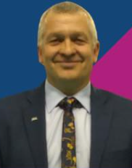
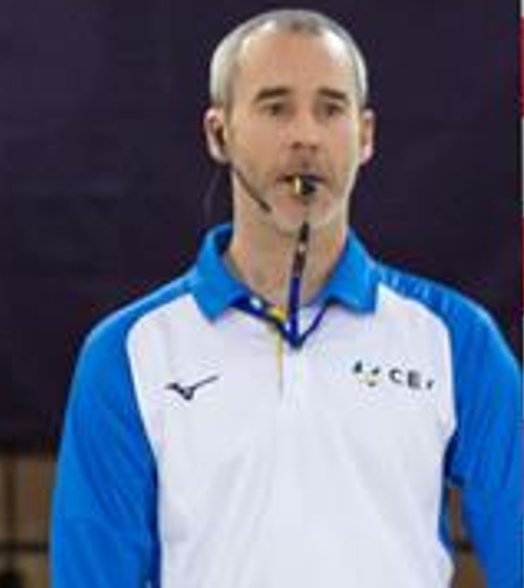

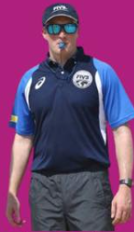

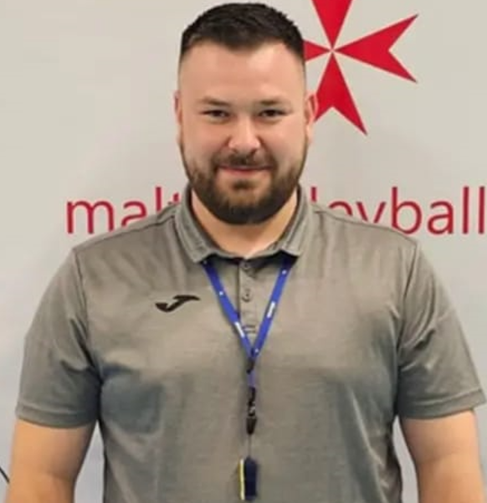
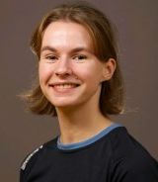
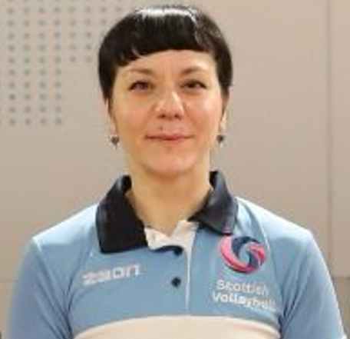
Introduction
Dave Cormie
Brian McDougall
John Swan
Sandy Steel
Jamie Salvin
Dominik Sirant
Rowan Johnston
Mari Sideri

Slide 4
Aim
The primary aim of the day is to:
Ensure all referees know the new rules
Ensure consistency throughout refereeing in Scotland
Commence a more structured CPD for referees through SV Learn
What we need from you:
Participation in the day – ask questions, interact, learn as much as you can
Go back to your clubs, educate Grade 4 referees, educate your coaches and players.

Slide 5

CONFLICT RESOLUTION AND DISCIPLINE

Slide 6


What does conflict management mean?​
Conflict management is the process by which disputes are resolved, where negative results are minimized, and positive results are prioritized.
Conflict management and resolution is not about who is “right” and who is “wrong”, but about being able to overcome a dispute by providing the best possible outcome for all individuals involved.

Slide 7
The External challenges​
External challenges that impact on our ability to exercise conflict prevention or resolution:
Lacking experience
Unfamiliarity with players/teams
Difficult/unique situations
Several refereeing commitments during the day
Social challenges including crowd management
Being assessed
TV or social media coverage

Slide 8
The Internal challenges​
Hyperarousal-levels of cognitive and mental activation as well as our alertness
How does that then impact on our Internal Resources and Resilience:
  Impact on our confidence
  Lack of ability to focus
  Physical effects of stress
  Excessive thinking-internalisation
  Impatience
  Our body language changes
  Our communication changes

Slide 9
How to prevent/manage conflict?​
Kindness and respect are universal, they create the right foundation to address unfamiliarity
Integrity and transparency are essential in establishing trust
Be aware of body language and facial expressions-by being relaxed and well-mannered we demonstrate that we are confident
Observe Teams and be aware of the age/maturational stage and how it impacts on team’s emotion management (i.e. U20’s in comparison to Senior teams)
Situation management – anticipate a potential issue and be ready to resolve it before it escalates
Active listening
Emotional Intelligence
Flexibility

Slide 10
How to prevent/manage conflict?​
Pre-match:
  Knowledge of rules - knowledge brings confidence in applying them
  Scenario planning supports effective management
  Avoid catastrophising, over-analysing

Slide 11
How to prevent/manage conflict?​
During the match:
  Remain positive - do not allow a mistake to have an impact on your ability to make future decisions
  Call what you see and do not try to compensate for a fault
  Decision making should be positively reinforcing and not punitive
  Anticipate - be able to read the game and team’s reactions in order to anticipate next moves
  Be prepared to answer the “why?” question and be clear in your communication
  Support and protect your team

Slide 12
How to prevent/manage conflict?​
Post match:
  Reflections
  Feedback
  Be competitive but not counterproductive

Slide 13
Conflict Management
Ask questions when appropriate, it is a form of respect that defuses resistance.​
Provide with both positive and negative options.​
Use disciplinary actions when appropriate, for restoration and not for punishment.​
And most importantly:​
By being aware of the potential problems you may encounter you become more ready to deal with them.

Slide 14
Discipline
What does it really mean in volleyball?

Slide 15
Discipline
Restoration of the game when conflict cannot just be managed through short discussions and verbal warnings
Fairness through the application of the Rules of the Game
Emotion management and containment
Confidence boost...and a Reminder that there is a judge to regulate the conditions – the Referee – and by implication, the teams have signed up to the articles of this "simulated war".

Slide 16
Act Confident – Be Confident
If you go into a match scared, or obviously nervous, it should be no surprise that players will challenge you. They want to win and if that means gaining an edge, they will do so.​
That might mean talking loudly when you make an unpopular decision to try to “gaslight” you​
Or they will shout in a manner which could be misconstrued as criticism​
Or they may try to lull you to false sense of friendship before turning on you!
Notes:
players will challenge you. They want to win and if that means gaining an edge, they will do so.
That might mean talking loudly when you make an unpopular decision to try to “gaslight” you
Or they will shout in a manner which could be misconstrued as criticism
Or they may try to lull you to false sense of friendship before turning on you!

Slide 17
More Confidence
The fact is that rallies last around 6 seconds – so be focused for this short time but when you make the decision ending the rally
Do so with a confident whistle and
Do so with a check of your line judges or fellow referee (3/4 people agreeing a decision is confidence building)
Do so with strong but relaxed signals
Remember ball handling is YOUR jurisdiction – the only opinion which matters!
(https://youtu.be/aoxff1s8frw?si=V5N-4RVYyKCbuG3q)
Notes:
https://youtu.be/aoxff1s8frw?si=V5N-4RVYyKCbuG3q

Slide 18
Know the rules
The game captain is the only person on court who can approach you.
The coach is the only person off court who can (unofficially) ask the scorer something which is not shown on the score board.
The coach cannot interrogate the 2nd referee! You may need to protect the 2nd referee (or line judge), and some coaches want to interrogate AFTER the match – be careful about that.
Notes:
https://youtu.be/aoxff1s8frw?si=V5N-4RVYyKCbuG3q

Slide 19
Know the rules
If the game captain approaches with a request for explanation, try to bend down to the same level – better than towering over the player.
Never dismiss the game captain’s request - provided the request is for explanation.
Never have BOTH game captains at the referee’s chair at the same time unless YOU are the one laying down the law of behaviour.
Never be afraid to consult your other officials – sometimes justice needs to be SEEN to be done.

Slide 20
Know the rules
Remember that under no circumstance should the Referee allow outbursts, excesses or insults.
Kindness does not include relinquishing control of the match – the referee may have to apply disciplinary sanctions if the circumstances so requires.
the members of the coaching staff must be controlled to stay within the limits of their rights without intervening in the game with actions or claims that are over-acted or excessive.

Slide 21
Know the rules
The 2nd referee is much closer to the coach comments that the 1st referee.
Some selective deafness is critical here. If you react to a coach comment, and the coach sees you, be aware that you will get many more comments.
Instead, walk to the other side of the post.
But if the comments are too vile or violent, then blow the whistle and indicate the coach; the 1st referee needs to support you now with a yellow card.

Slide 22
Your weapons
Disqualify directly (Red+ Yellow separately)
Expel directly (Red + Yellow together)
Warn (yellow card) – applies to individual (but applies to team as well)
Give verbal warning
Give unofficial warning/ gesture/ small admonishment
Catch someone’s eye
But you can dive in at any point, depending on how serious is the action of the player or coach
https://www.youtube.com/watch?v=YE-NlBR_Pzg&ab_channel=TheworldofvolleyballReferees
Notes:
Note, where the facilities are not in accordance with the playing requirements, the referee must request changes to bring the conditions to the correct level

Slide 23
Your weapons
In truth we can never convince someone who is angry about a decision simply by “force”.
The best we can do is suggest that together the referees and the players find the truth.
At top events that is done via a video verification system or by consultation through wireless headset communicators.
Few referees get the chance for this: but consultation is still possible. This has the advantage of giving cooldown time.
Notes:
Attack Line Note: We use this in almost all competitions – so it is not restricted to FIVB events. It permits a proper evaluation of players’ take-off points if back line (see key points on back line matters).

Slide 24
Things to consider
Often, cards are issued because the referee made a mistake…which precipitated player reaction, which precipitated more reaction…and so on…
Separate the criticism of a decision from criticism of you. Sometimes “selective deafness” is useful.​
Give yourself a deep breath to identify whether it is directed at you or the decision.​
This gives an opportunity for rational thought. Maybe your decision is now different
https://youtube.com/shorts/6gL03iENr8A?si=AenYDW6fPBxvaKtD
Notes:
Attack Line Note: We use this in almost all competitions – so it is not restricted to FIVB events. It permits a proper evaluation of players’ take-off points if back line (see key points on back line matters).

Slide 25
Disciplinary on swearing
“£$%^&*(!”, says the player, aimed at himself because of a poor shot
  LEVEL 1 WARNING
“For £$%^&*() sake ref”, says the player, aimed at the decision​
  YELLOW
“Ref that was £$%^&*()_)(*&^%$”, says the player, aimed at the referee and the decision
  RED
“Ref, you are a %^&*(&^%^&*”
  RED AND YELLOW

Slide 26
Don’t’s
Don’t be too “pernickety” or “nit-picking”
Don’t focus too much on things not on court
Don’t assume players/ coaches know all the rules
Don’t do that knee jerk reaction – to control the game you must control you and your emotions
Don’t get angry
Don’t tolerate bad behaviour (swearing, etc) – if your grannie would be offended, then so are the parents with small children in the venue.
Notes:
Note: Please WHISTLE the antenna fault; and look at the whole net on the block side!
Note: Please whistle when the ball hits the ceiling lights or beams the contact of the ball with the floor when the 1st referee is not in position to see the contact;
Notice this is FREE ZONE to OPPONENT COURT so the 2nd referee needs to take up good position and must WHISTLE this!

Slide 27
Do’s
Practice! The more you referee, the more you will see “everything” there is to see. The more you referee, you accumulate events which you store away as solutions. It is better to PREVENT these situations arising, rather than simply reacting to them.
Listen! There may be some validity to the team’s protest
“Let’s find out”/ “can I help”/ “let me explain”
Admit a mistake, it will make you more credible. But do not do this under pressure from a team.
Notes:
Note: Please WHISTLE the antenna fault; and look at the whole net on the block side!
Note: Please whistle when the ball hits the ceiling lights or beams the contact of the ball with the floor when the 1st referee is not in position to see the contact;
Notice this is FREE ZONE to OPPONENT COURT so the 2nd referee needs to take up good position and must WHISTLE this!

Slide 28

QUESTIONS?
If you have further questions, these can be emailed to referee@scottishvolleyball.org

Slide 29
THE RULES OF COMPETITION AND SCORESHEETS

Slide 30
The Rules of SV Competitions
The Rules of Scottish Volleyball Competitions govern all matters arising from the organisation, running, and management of each National Competition, including Cup and Playoff Competitions.
They are updated every year after the conclusion of the indoor season.
All matches will be played to FIVB Rules unless stated otherwise within the rule book.

Slide 31
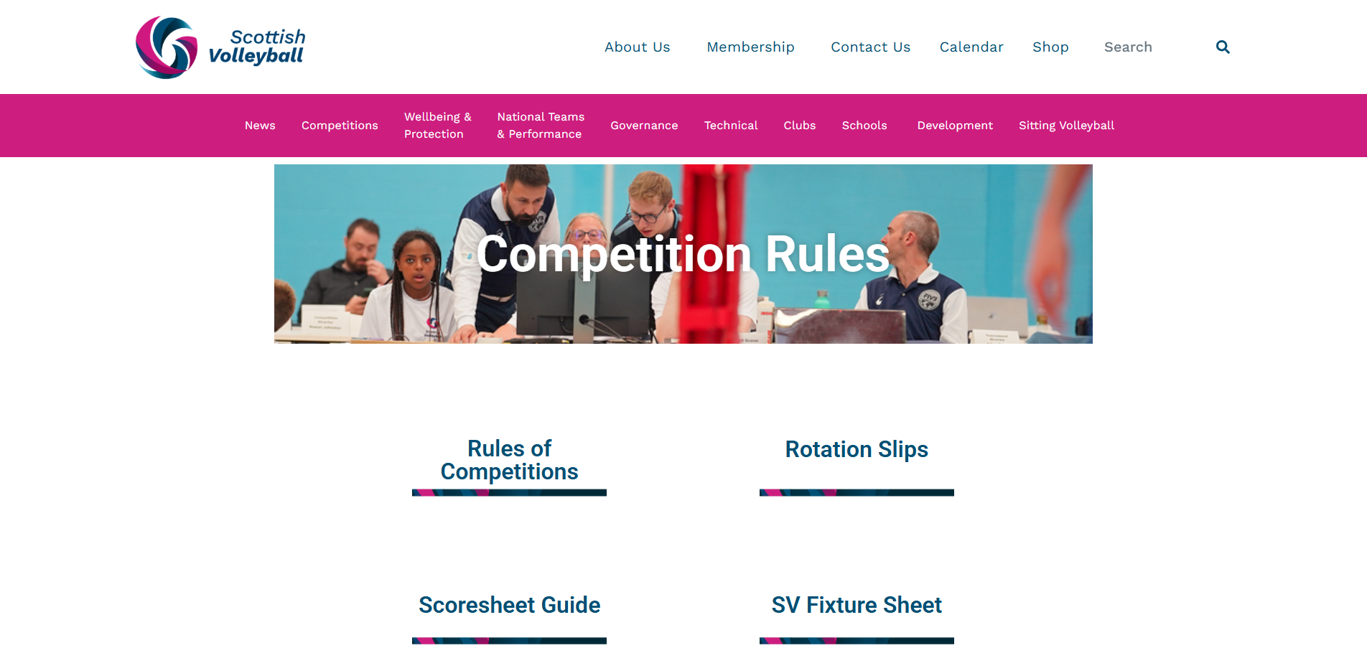
The Rules of SV Competitions
The Rules can be found on the website

Slide 32
The Rules of SV Competitions
What do the Rules mean for you as a referee?
  Includes information around player/coach registrations, match details and competition formats
  States payment details for referees
  Detail requirements that clubs must follow when hosting or participating in matches

Slide 33
The Rules of SV Competitions
Here are some examples of situations that have arisen throughout the last few seasons that the Rules of SV Competitions can help with!

Slide 34
The Rules of SV Competitions
  Situation Number 1:
  A team arrives at a venue. They have two liberos, one in white, one in red, and the rest of the team is in black.
  What do you do?

Slide 35
The Rules of SV Competitions
  Nothing!
  A team can have two liberos and they can be a different strips than each other. They must however be contrasting from the normal players’ kit.

Slide 36
The Rules of SV Competitions
  Situation Number 2:
  A host team only has 1 match ball, the rest are MVAs or something similar. What do you do?

Slide 37
The Rules of SV Competitions
  It’s the responsibility of the home team to provide the visiting team with a minimum of eight match balls for warm up (Rule 8.1.2).
  If a club fails to do this, it should be noted on the scoresheet in the remarks section and signed by the first referee.

Slide 38
The Rules of SV Competitions
  Situation Number 3:
  A team provides a printed copy of their team roster, with an extra player’s details added on in handwriting underneath.
  What do you do?

Slide 39
The Rules of SV Competitions
  Teams must provide a copy of an up-to-date (inclusive of all players playing in that fixture) collective licence (either paper or digital) with which they have been issued prior to the match.
  If a club can’t provide an up-to-date version on the day, the added player should not be allowed to participate in the match – adding players in after does not count.
  A player not on the team roster is ineligible to play in a match.

Slide 40
The Rules of SV Competitions
  Situation Number 4:
  A player (who’s on the team roster) is running late to the match. Their coach wants them on the scoresheet so they can play when they arrive.
  Do you let them on the scoresheet, and what should you do when they arrive?

Slide 41
The Rules of SV Competitions
  If a player is on the roster correctly, they can be added to the scoresheet, and can play on their arrival.
  However, we would recommend check that they are who they are claiming to be before letting them on court – 2nd referee can check this before allowing the substitution/letting them on court.
  If they do not arrive, they should be removed from the scoresheet at the end of the match.

Slide 42
Scoresheets
Scoresheets are the bread and butter of any competition we as referees are involved in.
Mistakes or errors can have a large impact on clubs/teams.
Scoresheets are returned every week with errors or missing information

Slide 43
The Rules of SV Competitions and Scoresheets
Key Reminders:
The Rules are there to help you!
Be consistent
Be vigilant – triple check your scoresheets before you sign them!

Slide 44
QUESTIONS?
If you have further questions, these can be emailed to referee@scottishvolleyball.org

Slide 45
RULES UPDATE

Slide 46
Rule changes
Why do we have rule changes
Recap on 2022 modifications
2025-2028 rule changes – released January 2025
Further updates – Summer 2025

Slide 47
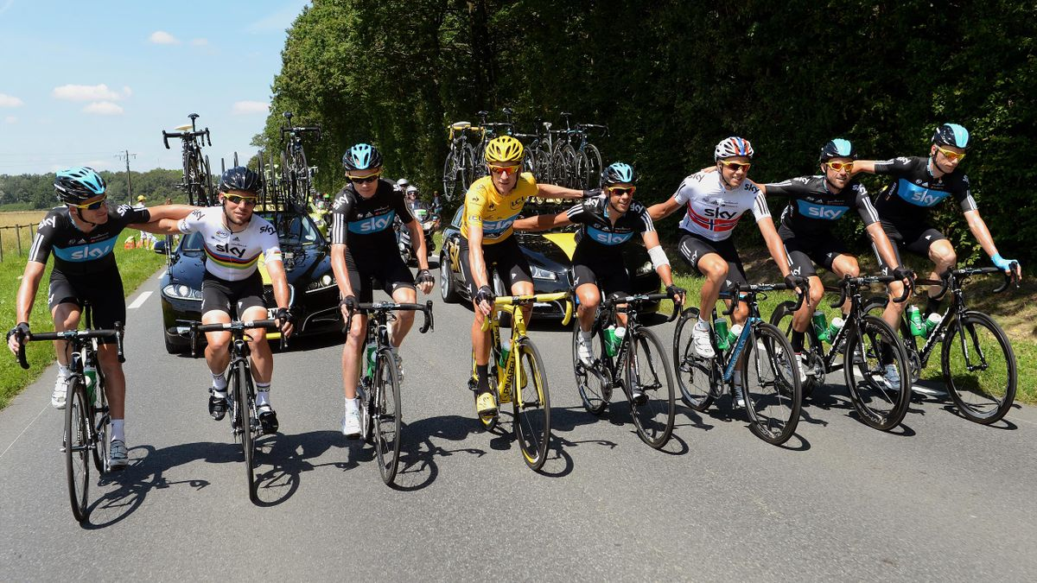
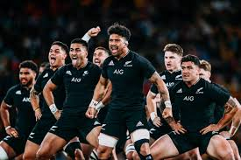
Why the changes?
To combat new skills / tactics
Sport is competitive – winning is essential
  Team Sky
  All Blacks
Sub requests / huddles / TOs / etc.
Notes:
Team Sky / Dave Brailsford – aggregation of marginal gains helmets / clothing / nutrition / pillows / massage gel / skin suits
All blacks – constantly pushing the limits of the laws
Winning is essential for sponsorship etc. people remember Team Sky – not so many know/remember Ineos Grenadiers
Telegenic

Slide 48
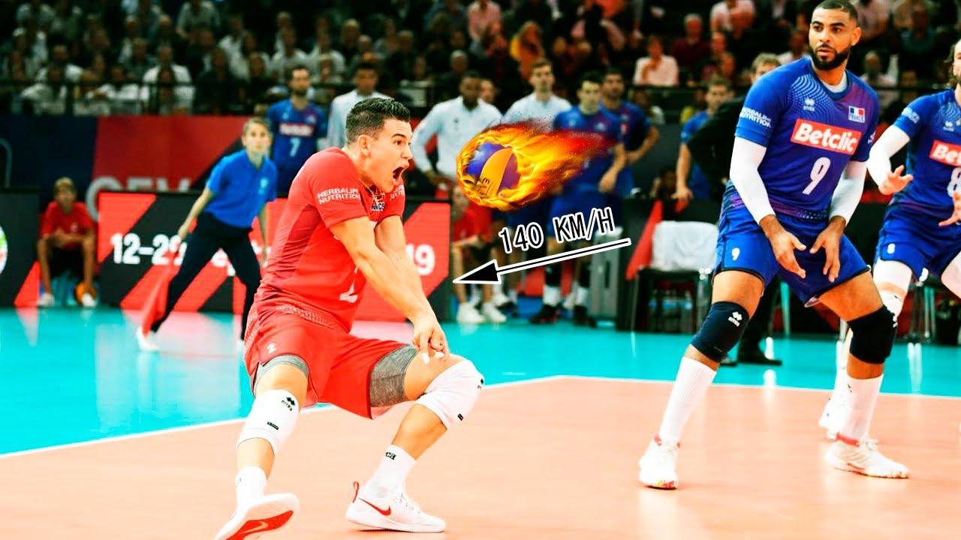
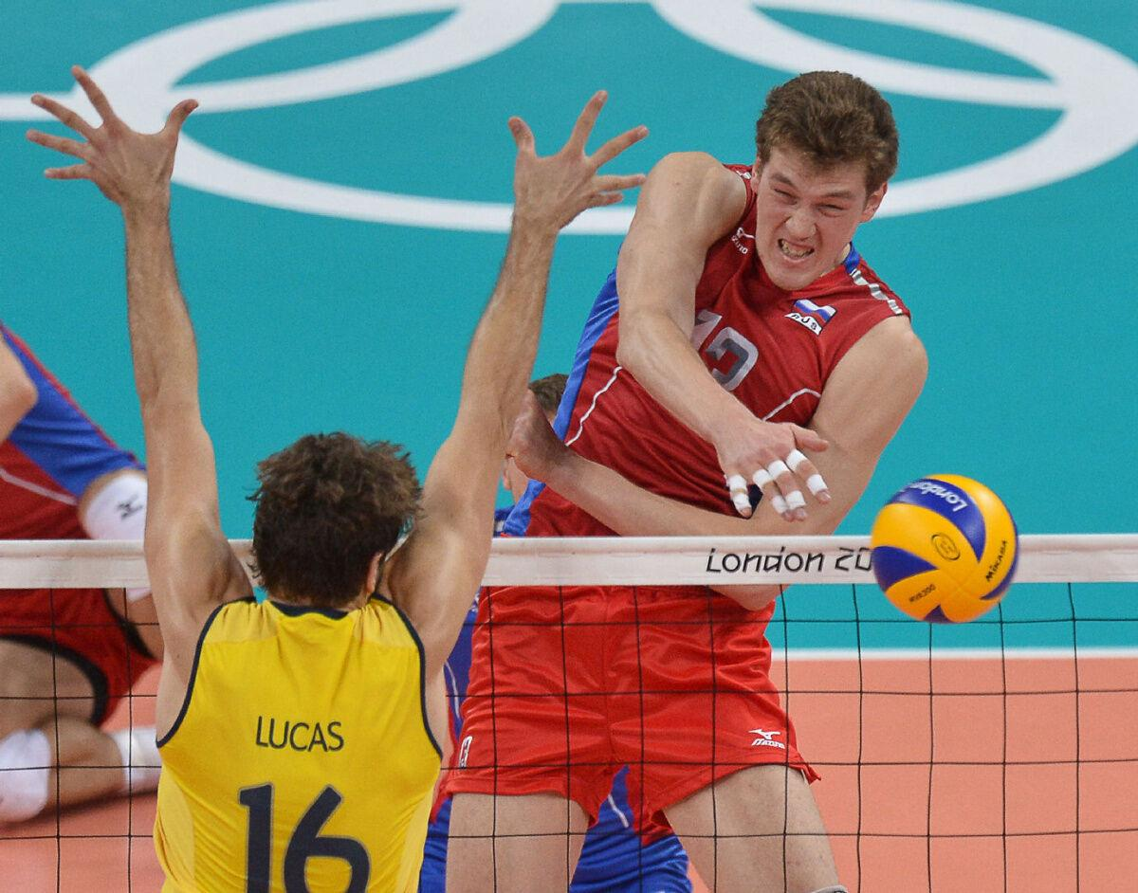
What are these new skills / tactics
Athleticism
Setter in zone 2 / Penetrating setters
Pipe attack
Wiping off block
Serve reception – liberos
Opposite – big beast!
Opposites hitting right side all the time
Delaying the game
Notes:
Jenia Grebennikov
Dimitriy Muserskiy

Slide 49
How do referees combat these
Apply the (latest) rules / guidelines
  Avoiding delays – quick subs/TOs
  Players positions
Be prepared:
  Scandicci vs THY Istanbul – semi-final CEV Cup
  SWNT – San Marino 2024 (and 2025)
  The art of refereeing / smooth refereeing
Notes:
THY Istanbul – watch videos / Turkish teams ‘like it’
SWNT – Danny chose to effectively play his opposite in an outside role, No big deal I hear –disrupt the San Marese (well done Danny) it also caused some problems for the second referee who was not expecting this.
Players getting an advantage? Let the players decide – still possible with the cameras?
Make the hard things look easy – practice and know the rules

Slide 50
Rules – 2022 modifications
Warm up area (rule 1.4.5) – can be behind the bench
Penalty area (rule 1.4.6) – no longer provided
Libero - team captain (4.1.2 and 5)
Compression pads – black/white/neutral – all players must be the same
Warm-up area and coach position (rule 5.2.3.4)
Playing ball above score table (rule 9) – full score table allowed
Foot touching opponents court (rule 11.2.2.1)
Screen – moving or grouped and service hit hidden and flight of ball hidden (rule 12.5.1 and 12.5.2)
Blocking in opponents space (rule 14.3 and 14.6.1) – simultaneous contact acceptable
Game interruptions (rule 15.2.4 – NEW)
Exceptional substitutions – expelled / disqualified (rule 15.7 and 15.8)
Libero tops can be different colours (rule 19.2)

Slide 51
Rules – 2022 modifications
New positions (rule 7.4.3) - why?
The change:
  Instead of focusing on the front player being completely in front of the corresponding back row player regarding the centre line, the emphasis changes to a focusing that back row player can be in front of the corresponding front player if he/she is at the same distance or at further distance regarding the centre line.
  This rule is in fact, dictated for the Volleyball played currently. In other words, the rule was adapted according the game.
Notes:
The change is at first sight very small, but the implications for the flow of the game are significant.
Currently, setters often try to beat the service hit by sprinting to the net while the ball is in mid-air from the toss. Often the player is in mid-air at the hit, having penetrated beyond the corresponding front court player, and the margins are often tiny.
If referees were to punish this every time the sport would be less attractive as it would be a series of side-outs without rallies.
This means, a more flexible interpretation, which will reflect a little more the reality of our current dilemma: at what point does the penetration go too far, and how does this reflect the 2nd Referee’s CONSISTENT application of the rule.

Slide 52
2025 changes
2025-2028 rule changes – released January 2025
  Screening
  Ball past the post
  Serving team positions
Further updates – Summer 2025
  Double touch
  Receiving team positions
  Remember
    Only work with the official rules communicated today

Slide 53
Screening – why the change
AIM: To enhance fair play by restricting the serving team players’ ability to raise arms above head height until the ball crosses the net.
Over last few years we have seen an increase in tactics and techniques to hide the server and the flightpath of the ball. This is providing an unfair advantage over their opponents.
Hence the attempt through modifying the Rules and reinforcing instructions in the Refereeing Guidelines to eliminate this behaviour and resume fairness in the game.

Slide 54
Screening – extract from Guidelines
The 1st referee should pay attention to screening during the execution of the service when a player or group of players of the serving team, waving arms, jumping or moving sideways or by standing grouped, prevent their opponent from seeing the server and flight path of the ball until the ball crosses the vertical plane of the net. So, if the served ball can be seen clearly throughout its path, until it crosses the net to the opponent, it cannot be considered as a screen. Referees must be more zealous in taking care of the teams' intentions to create a screen and prevent, from the beginning of the game, that the teams abuse the screening rule with the excuse of "tactical strategy."
Therefore, when a team is CLEARLY GROUPED with the intention of screening, or players are standing with hands above head height (they may, however, protect their heads for safety reasons but must not raise their hands above the head), the referee can indicate this to the serving team, by blowing his/her whistle, to separate the players, and, if they do not do so, the 1st referee MUST CALL THE SCREEN after the service.
It is necessary that ALL referees apply these instructions from the beginning of the matches, to reverse this trend that affects the fair play.

Slide 55
Screening - the ruling
Referees should not search for faults.
While the purpose of the rule is to prevent screening, the 1st referee has the duty to advise the player/ team to lower hands. It should not be assumed that an instruction to the Team captain at the toss will be passed on to the team mates.
In the example, the player was obviously confused. 1st referees should manage such situations partly as an educator, at the introduction of a new rule.
Hence, a quiet instruction to the player would have been the best solution, avoiding an overly strict application (in 2nd situation player did not seem to raise hands), a potentially critical point to opponents and confused players and spectators.

Slide 56
Screening - Explanation
Remember, the purpose of this rule modification is to ENHANCE FAIR PLAY: Players can still protect the back of their head by placing hands behind their head, but they may NOT raise hands above their head until the ball has passed the net plane.
This will apply even if they are not grouped in a “screening” position.
e.g. There is no reason why a player in position 5 or 6 should be standing with hands raised above their head.
There was never a restriction on referees advising teams that they were in danger of screening, so that this rule reinforcing the 1st referee’s ability to manage the match in this way should be welcome and allow fewer unexplained interruptions to play or deliberate screening actions
Note that this is ADDITIONAL to the existing screen rules.
Note: Should the served ball pass to the side of loosely grouped players without raised hands, or players who are simply switching positions, the receiver will be able to see the ball right from the service hit. This would not be a screen.

Slide 57
Ball past the post – why the change
AIM: Clarification of Rules 10.1.2, 10.1.2.1, 10.1.2.2, 10.1.2.3
Until now, when a ball was sent to the opponent free zone, the 1st referee had to wait until the ball was finally out of play before whistling the end of the rally – even if there was no chance for the ball to be played through the crossing space.
This made little sense.
So, the modification to the wording of this rules is designed to allow a common-sense approach by the 1st referee to whistle earlier in the rally and speed up the game.

Slide 58
Ball past the post – the ruling
The ball, coming from the first hit of the team, that has crossed the net plane to the opponent's free zone totally or partly through the external space, may be played back, within the team hits, provided that:
10.1.2.1 the opponent's court is not touched by the player (except Rule 11.2.2.1)
10.1.2.2 the ball, when played back, crosses the net plane again totally or partly through the external space on the same side of the court ‐ if not, it becomes ball out. The opponent team may not prevent such action;
10.1.2.3 the ball, sent to the opponent's free zone totally or partly through the external space, which has come from the second or third hit of the team, cannot be played back and will be judged as ball OUT the moment it crosses the net plane.

Slide 59
Ball past the post – explanation
As previously reported, it made little sense for the existing rule to allow the third hit in the opponent free zone, since it would be impossible for this hit to go to the opponent court through the crossing space.
The rewording of the rule allows the 1st referee to whistle the ball out of play and save valuable time and confusion during the match

Slide 60
Positions – why the change
AIM: To strengthen the defence and provide longer rallies
When the game is analysed, it becomes clear that attack dominates defence, around 70%-30%.
This means that the game becomes a series of side outs, since the receiving team’s first attack is largely decisive, winning the rally.
In order to modify this pattern, it was felt necessary to give the serving team the opportunity to organise its defence earlier – and this might best be served by allowing more freedom in positioning at the service.
Note: the receiving team has in recent years been given more switching possibilities, hence this team will not benefit from further free movement of players.

Slide 61
Positions – the ruling
7.4 Positions (see Diagram D4)
At the moment the ball is hit by the server, each team must be positioned within its own court (except the server). The players of the receiving team must be in the rotational order at the service hit.
The players of the serving team, however, are free to occupy any position at the service hit.
Note: Rules 7.4.1.1 – 7.4.3.2 remain unchanged.
7.4.4 After the service hit, the players of both teams may move around and occupy any position on their court and the free zone.

Slide 62
Positions – explanation
Remember, the purpose of the rule is to “strengthen the defence” – in other words, to give the serving team the opportunity to defend against the opponent first attack.
In this way, the attack-defence balance will shift away from the attacking side and there will be potentially fewer side outs. The serving team will be better prepared to defend against that first opponent attack.

Slide 63
Additional updates
Throughout the summer FIVB have continued trials regarding rule modifications / interpretations.
One rule modification and one new rule interpretation have subsequently been passed by the FIVB board and instructed by FIVB and then CEV for use within all competitions.
SV will follow these updates and as such from 2025 onwards there are modification to:
  Out of rotation for the receiving team
  Double Contact Interpretation

Slide 64
Out of rotation – receiving team
Expansion of the rule discussed earlier
Position of players in respect to each other remains the same
The determination of the player rotation occurs at the moment of the referee whistle
The determination of the players position (relative to each other) occurs at the moment of the service toss NOT the service hit.

Slide 65
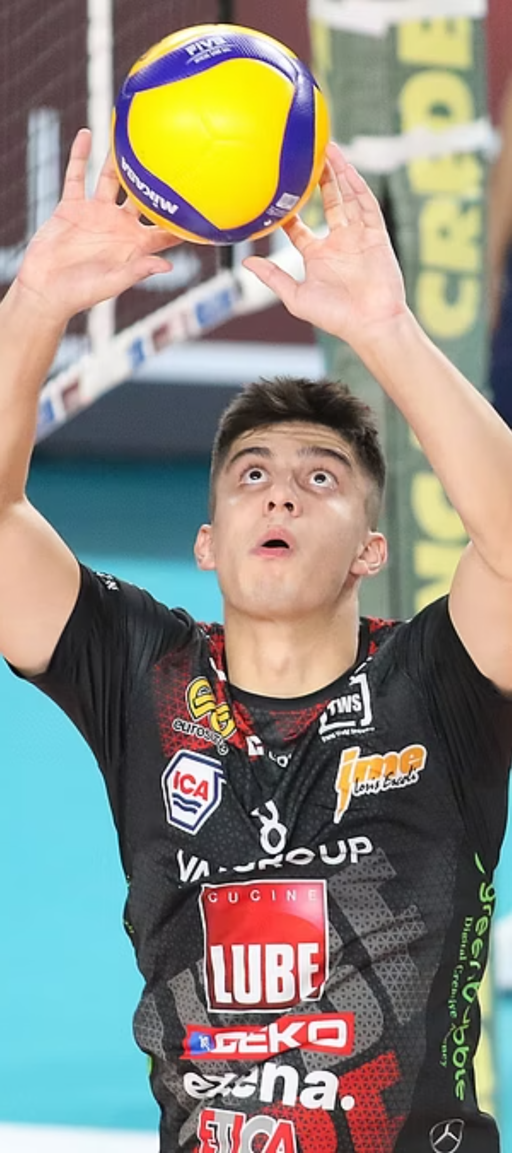
Double contact: Pre-2025 Interpretation
Traditional Definition
  A player hits the ball twice in succession, or the ball touches various parts of the body consecutively during a single attempt.
Subjective Judgement
  Officials made calls based on perceived "cleanliness" of contact or excessive ball spin, leading to controversial decisions.
Game Disruption
  Subjective officiating disrupted flow of play, affecting outcomes and frustrating players and coaches.
Notes:
The inherently subjective nature of the traditional double touch call was a significant catalyst for this rule change, as the FIVB seeks to streamline refereeing and reduce contentious moments.

Slide 66
Double contact: New Interpretation
No Fault:
  During internal passing/ second contact of the team, using an overhand finger action, consider NO FAULT if the contacts are made in one action
Definition:
  When passing the ball between teammates, using an overhand finger action, consecutive contacts with the ball in the hands are allowed, provided they occur during one action.
Notes:
The inherently subjective nature of the traditional double touch call was a significant catalyst for this rule change, as the FIVB seeks to streamline refereeing and reduce contentious moments.

Slide 67
Double contact: Faults
Fault:
  only when it is clear to see that the player has contacted the ball twice in a SUCCESIVE way.
Definition:
  Successive contacts: The ball slips through the player's hands and hits the head, or visibly makes separate successive contacts, this is a double contact, FAULT
Notes:
This represents a significantly higher threshold for calling a foul, moving away from subtle interpretations of ball spin or multiple light contacts.
Targeting great consistency in officiating between officials and matches, reducing disputes and unnecessary disruptions

Slide 68
Double contact: Attack Faults
Fault:
  All attack hits made with a “double contact” judged with the ”old” interpretation are still considered faults
Definition:
  Completed attack hits made in this way, will be judged as “double contact” FAULTS
Notes:
This represents a significantly higher threshold for calling a foul, moving away from subtle interpretations of ball spin or multiple light contacts.
Targeting great consistency in officiating between officials and matches, reducing disputes and unnecessary disruptions

Slide 69
Double contact: Summary
Although the "Official Rules of Volleyball 2025-2028" are in force from January 1, 2025, the double touch modification has been approved by FIVB and will now be used in SV.
The modification is to double contact handling faults only, we must remain strict in terms of our interpretation of ‘catches’.
Notes:
This represents a significantly higher threshold for calling a foul, moving away from subtle interpretations of ball spin or multiple light contacts.
Targeting great consistency in officiating between officials and matches, reducing disputes and unnecessary disruptions

Slide 70
QUESTIONS?
If you have further questions, these can be emailed to referee@scottishvolleyball.org

Slide 71
REFEREE BEHAVIOURS

Slide 72
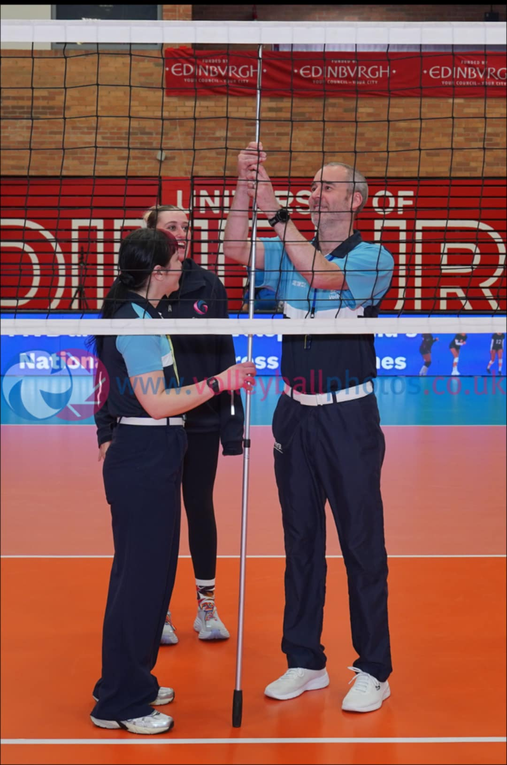
Uniform
Scottish Volleyball Referee T-shirt
Navy trousers
White shoes
White belt (optional)
No shorts, jumpers, hoodies, flip-flops or Crocs

Slide 73
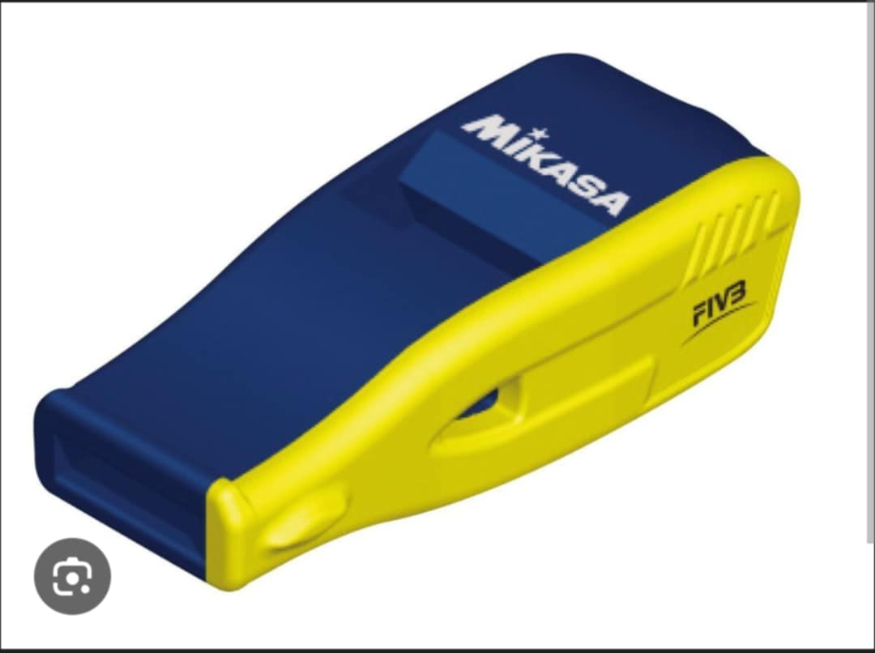
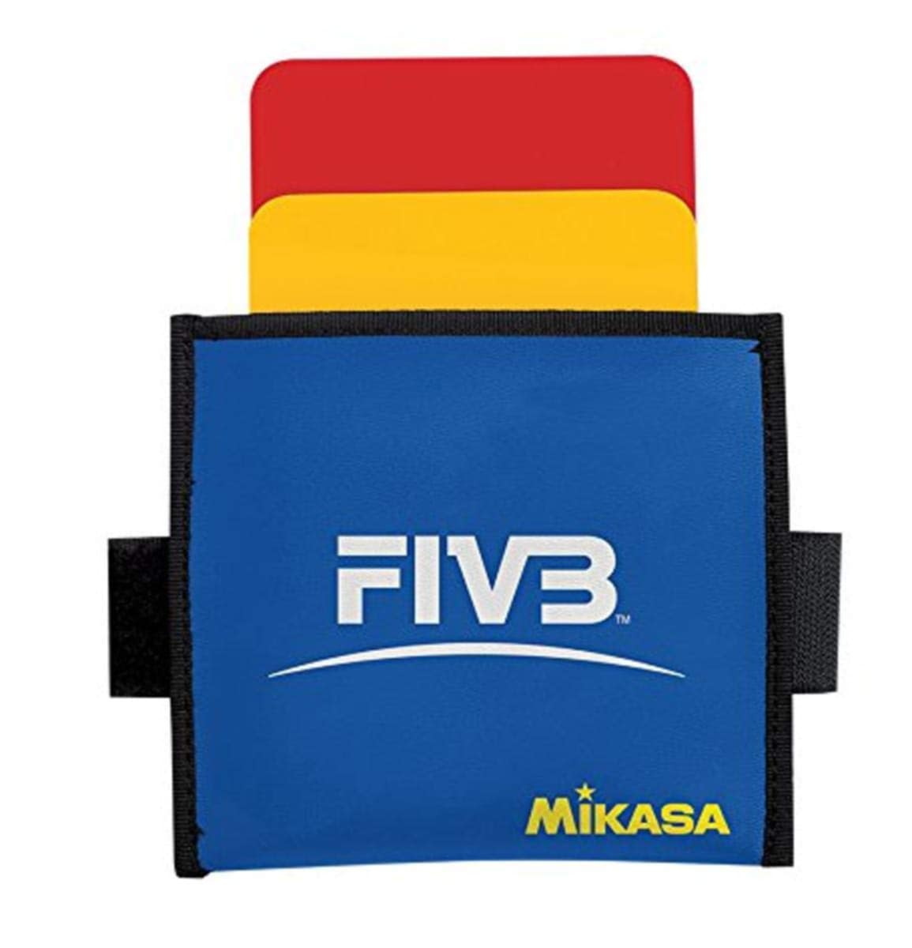

Equipment
Whistle
Cards
Coin
Watch
Net height measure
Pressure gauge
Pump

Slide 74
Hall / Court
Arrive at least 45 min before FBS
Foreign objects (basketball hoops, ropes, beams) - can they be moved or removed completely ?
Spectators seats
Floor (free of damage,holes or other objects)
Lines
Team benches
Score table
Warm up area

Slide 75
Pre-game equipment
Check your referee stand (Take your cards)
Check the net height, tension and that it is secured properly
Check the strings and straps are not loose and the posts are padded properly
Make sure there is enough balls for each team to warm up with and that they are pumped up correctly
You can check the matchball at this point too

Slide 76
Pre-protocol
Speak to second Referee
Speak to scorer
Speak to coaches
Make sure clubs have registrations ready for the scorer in plenty of time- this includes shirt numbers, captains and liberos
Speak to line Judges
Observe general warm up

Slide 77
The Protocol
- 14 minutes - Coin toss
-13 minutes - official warm up start up
Get both captain to sign the scoresheet
Get both coaches to sign the scoresheet.
Check team sheets against teams
Confirm captains, liberos, setters and Opposites
Get lineup sheets
- 3 minutes whistle and signal for warm-up to end
Say your good lucks and proceed to the stand
- 60 - 45 seconds whistle for teams to go on court

Slide 78
During the Game - Both Referees
Facilitate the game and keep the ball flying
Look Professional at all times
Speak appropriately to players, coaches and the officiating team
Take your time, asses, think, make your decision
Use correct signals
Do not give in to shouting, but consider that you might be wrong

Slide 79
During the Game - 1st Referee
Responsible for safety and wellbeing of everyone present
Read the spirit of the game
When necessary speak to captain
Use warnings and sanctions as necessary
Only team captain can ask for an explanation of a rule

Slide 80
During the Game - 2nd Referee
Hand out and collect line up sheets
Check rotations before and during sets
Help with Back Court attacks / Back Court Blockers
Substitution procedure
Libero Exchange
Communicate with scorer, coaches and 1st referee
Control the benches and warm up area
Control timings

Slide 81
Post Game
Shake hands with everyone
Ask captains to stay behind for signatures
Thank your team
Check the Score sheet
Sign the Score sheet

Slide 82
QUESTIONS?
If you have further questions, these can be emailed to referee@scottishvolleyball.org

Slide 85
Courses - Grade 4
Enrolment via SV Membership website
Online theory part
Practical day
Written exam
Confirmation of pass or requirement to re-sit any parts
Register as referee on SV Membership website
If you have multiple candidates reach out and we can look at using your venue to host a course
Notes:
Theory – all completed in advance (gives more time on court).
Theory – covers referee philosophy, rules, key cases which beginner referee may encounter
Practical – R1, R2, LJ, Scorer – Whistle and playing!!
Exam – multiple choice
Must pass all three components (Exam 80%)

Slide 86
Grade 4 – organising a course
To organise a course you need to:
  contact the Referee Commission and agree two possible dates
  book and pay for a sports hall and equipment
  arrange players to participate in practice games (sometimes this can be other candidates on the course)
The Referee Commission can help with:
  finalising the date and organising the course tutor
  advertising
  collate candidate details
  some of the hall hire costs

Slide 87
Grade 3
The participants should complete theory before the practical day / there will be a refresher session before the first games.
Participants will be expected to act as
  1st Referee
  2nd Referee
Multiple assessments over the course of the day/weekend
Participants must bring their own whistle, coin, red and yellow cards!!!!!

Slide 88
The appointment system
WhosTheRef
Clubs:
  Information sharing early
  Who are your administrators
  Changing details / cancelling matches
Referees
  Availability
  Notes
  Joining the system
Notes:
WhosTheRef used to appoint referees to all Premier League Matches – also SVL 1 but generally not done.
Information is needed early early early so that officials can be appointed
Admins – we need phone numbers too in case referees have problems on the day

